Slide 1
Historical Transitions & Contemporary Connections in Glassmaking

Slide 2
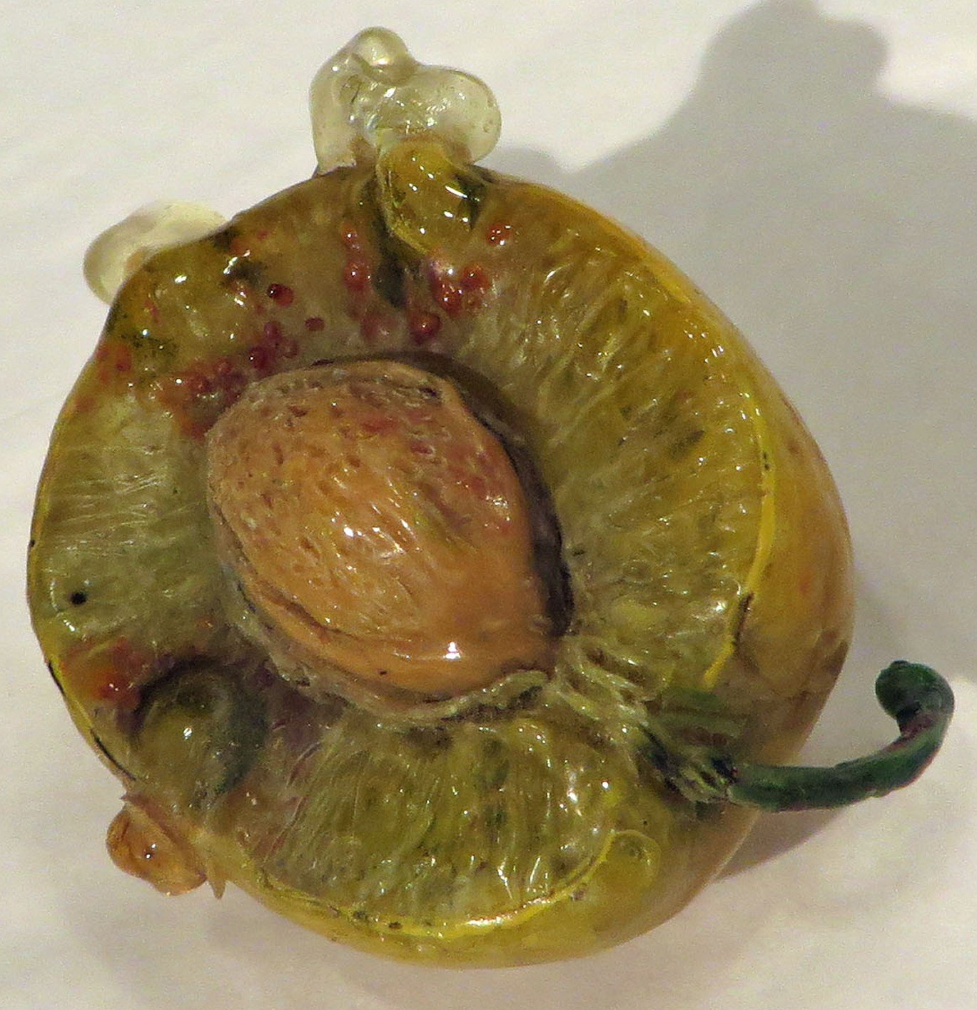
Introduction
Introduce new contexts to consider the development of glass
make connections to the adjacent & influencing occurrences of the time period
intersection of movements & artists
contemporary application
selected artists and movements to create connections with contemporary glass
discussion of use of material and the choice of material
Significance of object making
Half Oval Form of Plum – 1880-1890
Leopold & Rudolf Blashka
Lamp worked & painted
Image Link: https://www.cmog.org/artwork/half-oval-form-plum-half-0?search=collection%3Ae277bc5c23966142c048f439f21dd959&page=2
Notes:
Understanding the significance of the applied arts and media typically deemed as craft, where process and material are at the precipice of innovation.
I would also like to suggest that there may be other was to work during political and social change such as the artists I will be presenting. There is a tremendous amount of introspection, the common interest and gaining a broader audience. With this thought I would like to pose to the audience the contrast with contemporary work that is created really for a select few and limited audience while excluding or isolating others in addition that the audience tends to be of like minds.

Slide 3
art, craft, design, medium & the object
art
design
craft
symbiotic relationship of the elements of making
The diagram depicts the hierarchical or limited interaction of these elements.
Notes:
The discussion will not be to identify what is art, craft or design or bogged down rather that they cannot exist without the other.
It is hard not to recognize or call the maker the artist. However, for the sake of clarity the terms artist, designer and craftsman will be used to denote the part of the process. For example, during the Wienerwerstatte the artist/designer is interested in embracing the knowledge and ability of the craftsman or in this case the glassblower, cutter or engraver. These same craftsman will also go on to further manipulate the material to create new processes.

Slide 4
The intersection or interaction how do you see it?
sphere diagram demonstrates free movement
intersection of these elements
object
material
art
design
craft
art
craft
design
Notes:
In this proposition the sphere diagram demonstrates free movement of these elements to interact and be applied equally and as deemed by the artist. They are part of the same matrix.
The lower diagram shows the intersection of these elements and could be said where the real creativity and making happens. Although this shows that there is some division.

Slide 5
Timeline and Movements
Below is a list of selected movements and their approximate dates. The yellow highlighted will be our focus. The others will be mentioned to demonstrate the development of ideas.
On the following slide you will find a timeline which illustrates how these movements overlap.
c1860-1920 – Arts & Crafts movement in UK (similar revival influenced by US)
c1870-c.1915 – Arts & Crafts movement in USA (revival in 1970’s to present)
1890-1905 – Art Nouveau – French Origins
1895-1914 - Jugenstil – German Art Nouveau
1897-present - Vienna Session
1900-1945 – Art Deco – primarily US
1903-1932- Wiener Werkstatte – sub-movement, artist collection, related to Vienna Secession
1907-1922 – Cubism – general
1911-1914 – Orphism – branch of Cubism, Czech Cubism
1919-1933 – Bauhaus
1933-1957 – Black Mountain College – founded by ex-Bauhaus members
Notes:
This is a list of movements that I have been particularly interested. Primarily because it gives a good foundation for understanding how art will develop into the 20th and now the 21st century as it relates to what is deemed as the applied arts. It is a time when the world is going through immense political and social change. The artists themselves are also going against the norms and against the status quo.

Slide 6
Timeline with overlap of movements
Weiner Werkstatte 1903 - 1932
Jugendstil 1895 - c.1914
Arts & Crafts US c1870 - c.1915
Arts & Crafts UK c1860 - c.1920
2019
Before 1890
1895
1900
1905
1910
1915
1920
1925
1930
1935 & beyond
2019
Today
Art Nouveau1890 – c. 1914
Arts Deco 1900 - c.1945
Vienna Secession 1897 - ??? present
Bauhaus 1919 - 1933
Black Mountain College 1933 – 1957 in USA
Notes:
As we proceed it is at times hard to separate or differentiate between specific movement as they are fairly intermingled. You will also notice that some of the terms that are used relate to geography. An Example would be the Jugendstil which in some sources call the German Art Nouveau.

Slide 7
Leading up to the turn of the 20th century
What is the overall idea being addressed by the following movements?
ARTS & CRAFT MOVEMENTS USA c1870-c1915 UK c1860-1920 ***dates are approximate and may differ between sources***
ART NOUVEAU
1890-1905 These dates are approximate and may differ between sources. It is obvious that this movement extends beyond the end date listed.
JUGENDSTIL 1895-c1914 These dates are approximate and may differ between sources.
Notes:
The following movements seem to be struggling with a few fundamentals. It might be said they were struggling with their creative identity. The artist, designer and craftsperson are now molding into one in some cases. These people are rising from the traditions but still holding on, they are trying to embrace the identity of the material and refined elements of decoration while opposing the mas production. This lends itself to the item of luxury which is contrary to the underlying principles that through the art & craft, how it is conceived and created, will be uplift society and every citizen can participate.

Slide 8
Arts & Craft Movements USA c1870-c1915 UK c1860-1920 ***dates are approximate and may differ between sources***
The arts & crafts movement of this period is much different than we think of arts & crafts today. There are some interesting links between the participants and the later movements.
Select list of artists of US A&C Movement:
Marie Louise McLaughlin –
Marie Longworth-Nichols (later Belamy Storer) – Vienna Secession connection
Frank Lloyd Wright
Louis Comfort Tiffany
Christian Herter – French Art Nouveau connection
Gustav Stickley
Select list of artists of UK A&C Movement:
AWN Pugin
William Morris
John Ruskin
Edward Barne-Jones
Charles Robert Ashbee
Arthur Heggate Mackmurdo
Christopher Dresser
Notes:
The Arts & Crafts in the USA is a time when the material and process become the point of departure. The single object now holds significance. And the utilitarian component becomes secondary. In a sense the function is following form. The entire work should speak of the process and the material. Ideas are based on the material and the object should speak of the material qualities.
The UK side has some similar elements to the US version. Some resources show this influencing the US Arts & Craft Movement. AWN Pugin becomes the initiating force behind what will become the Arts & Crafts Movement in the UK. The primary impetus follows the notion of integrity of design and construction.

Slide 9
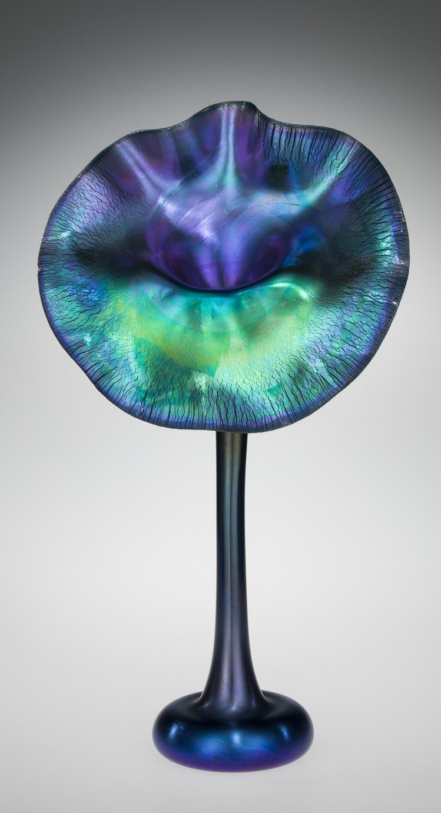
Louis Comfort Tiffany
“By the aid of of studies in chemistry and through years of experiments, I have found means to avoid the use of paints, etching or burning, or otherwise treating the surface of the glass so that now it is possible to produce figures in glass which even the flesh tones are not superficially treated – built up of what I call ‘genuine glass’ because there are no ticks of the glassmaker needed to express flesh.”
Louis Comfort Tiffany from The History of Craft, Edward Lucie-Smith, pp 228-9
“The second important thing about Tiffany’s products was the stress which was put on the importance of process - the finished result was as always, as much as anything, a statement about technique.”
The History of Craft, Edward Lucie-Smith, pp 228-9
The form of this Favrile “Pansy” vase was first made by glassmaker John Hollingsworth (American, born England, 1851–1923). Hollingsworth, and all of Tiffany’s talented glass makers, were encouraged to experiment at the furnace. The iridescent sheen of this “Pansy” vase was achieved by spraying tin chloride on hot glass and reheating it in a reducing (decreased oxygen) environment. Although the term “Favrile” is often used to describe Tiffany’s iridescent glass, “Favrile” was actually used to describe all glass produced by the factory. On November 13, 1894, Tiffany registered “Favrile” as a trademark with the US Patent office (no. 25,512).
https://www.cmog.org/artwork/favrile-flower-form-vase-1
“Morning Glory Paperweight” Vase
c. 1914
https://www.cmog.org/artwork/favrile-paperweight-vase-morning-glories
“Pansy” Vase - Favrille
Made by: John Hollingsworth
c. 1913

Slide 10
Art Nouveau 1890-1905 These dates are approximate and may differ between sources. It is obvious that this movement extends beyond the end date listed.
List of artists:
Eugene Gaillard
Emile Galle – Self and factory
Maurice Marinot
Baccarat - Factory
Lalique – Self and factory
5 main rules – Eugene Gaillard – French designer.
A piece of furniture shall as far as possible express its function.
Respect for the nature of the materials.
No unnecessary construction elements.
In wood an arch is only to be regarded as a decorative element
The ornament should be abstract.
Notes:
The Art Nouveau continued the thoughts of crafts and the hand made related to utilitarian objects. They held that the decorative arts were at the same level or on par with the fine arts; painting and sculpture. The work of this movement reflects the combination of new ideas with traditional elements. There was also a search for uniqueness through sophistication of technique. The end products tended move towards items of luxury.

Slide 11
Maurice Marinot
Plate with Rose
Enameled blown glass
Manufactured: Viard Glassworks
Bar-sur-Seine, France
https://www.cmog.org/artwork/plate-rose
https://blog.cmog.org/2013/03/27/early-pioneer-in-glass-maurice-marinot/?utm_source=rss&utm_medium=rss&utm_campaign=early-pioneer-in-glass-maurice-marinot
Notes:
Maurice Marinot started as a Fauvist painter. As his interest in glass grew he designed enameled glass for the factory Eugène and Gabriel Viard in Bar-sur-Seine, France. He received many accolades for his innovative designs and then became more interested in the process of glassblowing leading him to not only design but blow the glass himself. He was interested in the one of a kind work and I would translate to object making. He was not designing for mass production. The counter to this would be René Lalique. Marinot’s blown glass is reminiscent of what was happening at the beginning Studio Glass movement and also The American Studio Glass Movement in the 1960s.

Slide 12
JUGENDSTIL 1895-c1914 These dates are approximate and may differ between sources.
Attributes:
Simple dynamic lines
Ornament must be original not historica
Organic contrasted with geometric
Introduction of technology for purpose of quality, not all agree
Machine becomes an extension of the hand
Unifying all the arts and associated media
Select list of artists:
You will notice that these artists are also active or considered as part of other movements. Some listed below will be integral to the Vienna Secession
Henry van der Velde – founded the Kunstgewerbeschule, Weimar, Germany
Richard Riemerschmid
Benrhard Pancock
Peter Behrens – proto-modernism
Hermann Muthesius – founder of Werkbund, 1907
Werkbund members:
Peter Behrens, Josef Hoffmann, Joseph Olbrich, Richard Riemerschmid
Loetz – Self and factory
Leopold Bauer
Moser Crystal - Factory
Notes:
The Jugenstil, translated as Young Style, produces two significant concentrations of artists’ workshops in Dresden and Munich Germany. You will notice that there are links to the previous movements. Here the artists were searching for national art that rejected stylistic imitation, ornament must be original not historical. They were interested in the new and not replicating traditional styles. Much of the work was similar to and directly influenced by the Art Nouveau. They embraced organic forms contrasted with geometry.
The work produced depended on close collaborations with the artist and artisan, craftsman or maker. Many of the artists were multidisciplinary and could work with several mediums or where knowledgeable at the very least.
Initially inspired by William Morris, the Jugenstil would succumb to the necessity of the machinery used in production which was counter to the previous movement’s philosophy. Holding the similar ideas of the Art Nouveau which was not afraid of technology. This led to the ideas of standardization in regards to quality of perfection of form. Later there was a mild return to recent German/Austrian production and traditions. The products and influence of this movement can be seen in Swedish Design after 1930.

Slide 13
Peter Behrens
Liqueur Glass
Mold blown, enameled glass
12.9 X 5.5cm
1902
https://www.cmog.org/artwork/liqueur-glass-14
Set of Drinking Glasses with Ruby Glass Feet
Blown glass
Manufactured: Rheinische Glashutten-Actien-Gesellschaft
Koln, Germany
https://www.cmog.org/artwork/set-drinking-glasses-ruby-glass-feet
Notes:
The theme of the multiple interests will continue with upcoming artists. Many of them, such as Behrens were, were interested in a holistic experience in some ways. Behrens, as some of the subsequent artists, was trained as an architect and at this time would also mean he would work in the fields of design and industrial design. He was designing work that would be made and used. In this case the user was also important. This set of glasses is an example of this. They were designed to be used in the dining room of his home that he also designed as part of an artists’ colony in Darmstadt, Germany. The furniture and other elements were also deigned by Behrens. His interest was about the use of material and the object.
The first grouping here is related to the Jugendstil. While the second is more closely aligned with the Wienerwerkstatte. As we have seen with both of these examples, they are clean and to the point. They utilize the current technology and what is happening at the time with the material. This is shown with the use of gold luster. The making of an object like this would include the designer, mold maker, glassblower, glass cutter and glass painter.

Slide 14
Leopold Bauer 1872-1938
Links:
https://www.woka.com/en/lexicon/leopold-bauer.html
http://www.artnet.com/artists/leopold-bauer/
https://www.mackintosh-architecture.gla.ac.uk/catalogue/name/?nid=BauLeo
Titania
Blown glass
24.5cm X 27.8cm
Designed for Loetz exhibit at World’s Fair, Milan, Italy
Manufactured: Johan Loetz Witwe - Bohemia, Klastersky Mlyn, Czechia (currently)
https://www.cmog.org/artwork/titania-vase
Notes:
Leopold Bauer was a born in what is now Czechia near the Polish boarder. He studied architecture under Otto Wagner at the Academy of Fine Arts in Vienna where he later took over as head of the program.
Bauer is another example of the architect's influence that we will continue to see. With this work, Bauer is working directly with Johann Loetz Witwe a Bohemian glass manufacturer. He would also design work for J&L Lobmeyr. Due to the time period and structure of Europe at this time much of the work was being designed in Germany and Austria but executed in Bohemian factories. The mastery of these glassmakers would be essential to the further exploration discoveries and innovations to come. This also demonstrate the interest of the designers to work directly with the craftsman and hold them in equal regard.
This blown glass object has some interesting characteristics that are reminiscent of techniques use in Tiffany’s design. The lower green elements refer to the natural world, being leaf like and made using the feathering techniques. There is an intended contrast with the interior orange, the exterior green and iridescent metallic surface.
The object is large in scale compared to many other object being made in glass at this time.

Slide 15
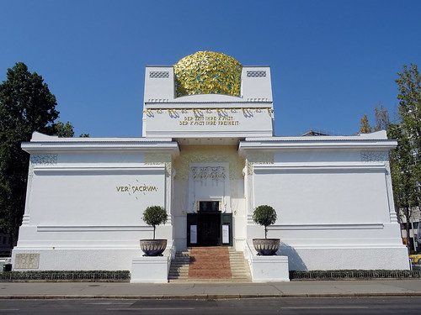
The Vienna Secession & The Wiener Werkstätte
"Der Zeit ihr Kunst - der Kunst ihr Freiheit"
(To the Age its Art; to Art its Freedom)
The Secession Building
Designed by Joseph Maria Olbrich
1897-1898

Slide 16
The Vienna Secession 1897-present(?) Also known as the Secessionist in art speak ***dates are approximate and may differ between sources***
"Our art is not a combat of modern artists against those of the past, but the promotion of the arts against the peddlers who pose as artists and who have a commercial interest in not letting art bloom. The choice between commerce and art is the issue at stake in our Secession. It is not a debate over aesthetics, but a confrontation between two different spiritual states." - Hermann Bahr (literary critic) , Ver Sacrum ("Sacred Spring")
Fahr-Becker, L'Art Nouveau, pp. 335-340
https://en.wikipedia.org/wiki/Vienna_Secession
Selection of founding artists of the Vienna Secession:
Gustav Klimt
Joseph Olbrich
Josef Hoffmann – we will see a lot of this guy
Koloman Moser
Max Kurzweil
Wilhelm Bernatzik
Rudolf van Alt
Notes:
The first part of this presentation you will introduce the main artists and ideas that embody the movement. You will see diverse thinking and practice as these artists attempt to establish a cohesive thought.
While the Secession is seen as a “fine arts” movement, I believe it to be significant to the development of glass as it happens parallel to the other movements. I also want to express the reality and purpose as this same term has been used with contemporary glass. I will leave it up to the audience as to whether they are actually related and whether the term is appropriate in the contemporary context.

Slide 17
Ideas Addressed
Overall ideas:
Renewing of focus on the decorative arts
Called for greater integration of all fine & applied arts
Establish exchange of ideas internationally
Against the establishment in academia
Against the current art solons of the region
Create space to exhibit for the artist – first dedicated exhibition space for contemporary art in the west
Visual focus:
More diversity in expression
Interest in the use of architectural elements and influence
Ornate and elaborate decoration
Contrast of geometry, fluid line, organic and sensual decorations
Integration of object and environments – holistic environmental approach
Notes:
Not unlike the other movements we are discussing, the Secessionist were breaking away from traditional norms. The Vienna Secession was another attempt at departure from the mainstream conservative and traditional art that was being made primarily in Europe and especially Vienna. The Wienerwerkstatte was an extension of the Secession that held to the original idea of full integration of the arts. These artists were tired of the stuffy ideas and controls of the past. Their interests brought them to international recognition which aligned with their beliefs. Initially there was a great interest placed on linking this movement to artists around the world initiating an international scene or awareness and with the intent of and international dialogue. The Secession aimed to move past motives of commercialization and at the same time narrow the gap, or eliminate the gap, between the fine arts (painting sculpture) and applied arts.

Slide 18
Artists from the ViennA Secession
Selection of other artists related to the Vienna Secession:
Alfred Roller
Peter Behrens - Ludwig Mies van der Rohe, Le Corbusier and Walter Gropius worked for him at one point.
Otto Wagner
Alfons Maria Mucha
Max Klinger
Carl Moll
Maximilian Liebenwein
Egon Schiele
Jean Luce
Jean Puiforcat
Charlotte Perriand
René Herbst
Vally Wieselthier
Gudrun Baudisch;
Fritz (Friedrich) Waerndorfer
Josef Maria Auchentaller
Othmar Schimkowitz
Jože Plečnik
Leopold Forstner (1908-1911)
Johann Loetz Witwe
Teodor Axentowicz
Renate Bertlmann
Adolf Michael Boehm (Böhm)
Julian Fałat
Wlastimil Hofman
• Oskar Kokoshka
Maximilian Liebenwein
• Jacek Malczewski
• Julius Mayreder
• Emilie Mediz-Pelikan
• Józef Mehoffer
• Maximilian Pirner
• Kazimierz Pochwalski

Slide 19
Gustav Klimt 1862-1918
The Kiss
72in x 72in (180cm x 180cm)
1903
Klimt, Freud & Jung
https://suitesculturelles.wordpress.com/2011/08/24/vienna-secession-klimt-freud-and-jung/
“Pansy” Vase - Favrille
Made by: John Hollingsworth
c. 1913
Notes:
Probably the most common work by Gustav Klimt, it speaks of the movement and the time. This painting embodies the prime example of the Vienna Secession. It contrasts the geometric with organic and speaks to the exuberance and decadence of the new time. This is a time of change in politics and art. The population is finding its release and experiencing the world in new ways. With the advent of Freud and psychoanalysis, there is an introspection that happens in the population. Although not commonly linked, Carl Jung also had some influence with ideas of transcendentalism and eastern thought. Eastern influence was working its way into other areas with art from China and Japan to Islamic influence in the coming years. You can see this in this image as well, highly decorated and ornate with the use of gold leaf. The rich patterns, draw from nature while the structure reminds us of architecture.

Slide 20
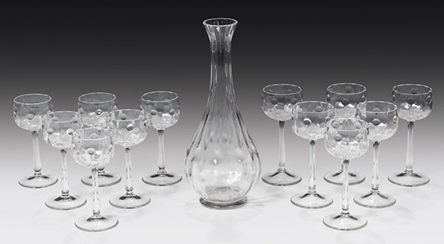
Joseph Olbrich
Drinking Set
Mold blown glass
Size variable, cups 14.5cm
http://www.artnet.com/artists/joseph-maria-olbrich/pieces-of-the-service-no-107-Az4xWjOoVI7uhTrlEu3ysg2
The Secession Building
Designed by Joseph Maria Olbrich
1897-1898
https://www.visitingvienna.com/footsteps/secession/
Other Link: https://www.idesign.wiki/joseph-maria-olbrich-architect-designer-and-graphic-artist-1867-1908/
https://www.inexhibit.com/mymuseum/secession-vienna/
"Der Zeit ihr Kunst - der Kunst ihr Freiheit"
(To the Age its Art; to Art its Freedom)
Notes:
Joseph Olbrich is one of the founding members of the Vienna Secession along with Gustav Klimt, Koloman Moser and Josef Hoffmann. He was born in Silesia which is modern day Czechia. This connection with the Czech region and glassmakers would continue throughout the century for designers and firms related to these movements. He designed the the Vienna Secession Building. As with his other architecture compatriots, he would work closely with some of the leading glass firms to design elegant refined glass. These were primarily designed for serial production. He would later leave to cofound the Deutsher Werkbund in Germany.

Slide 21
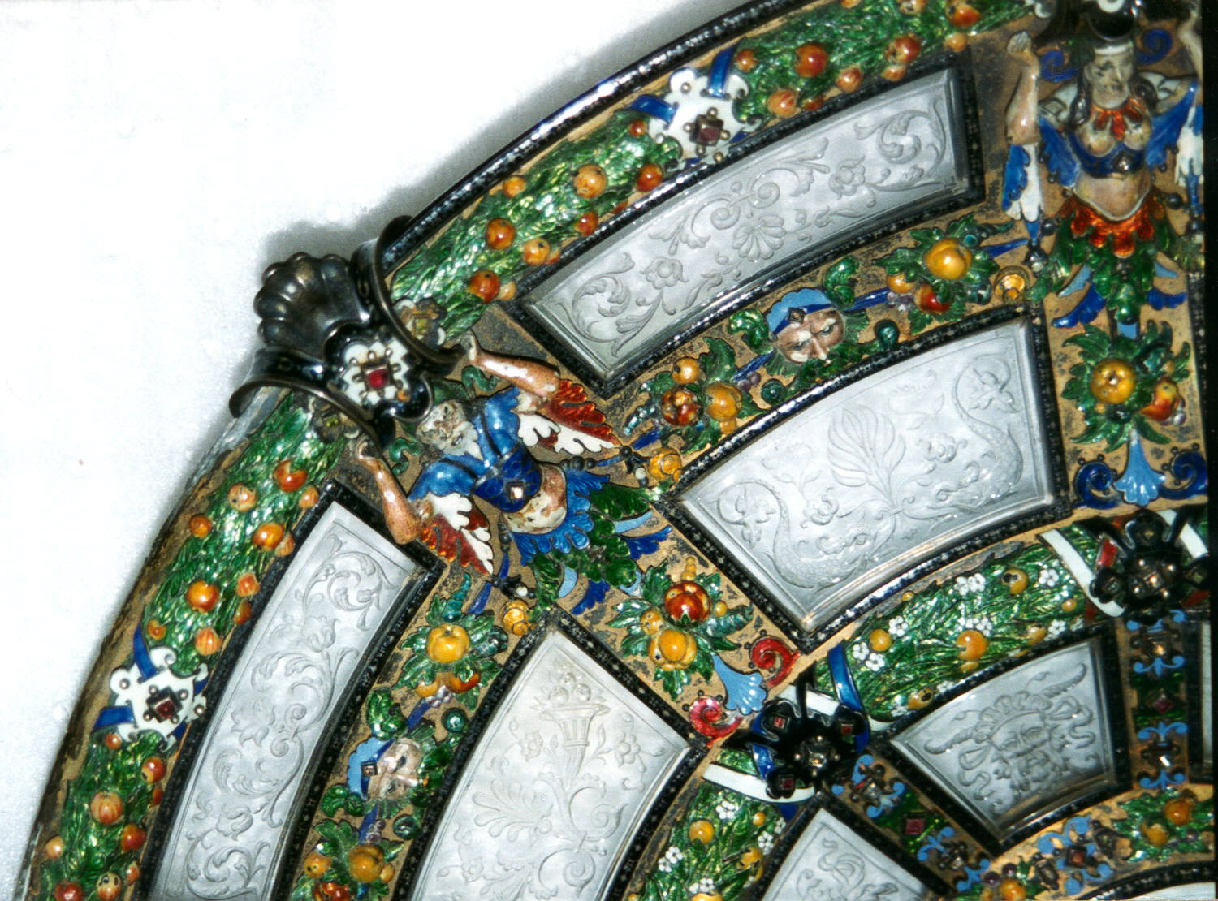
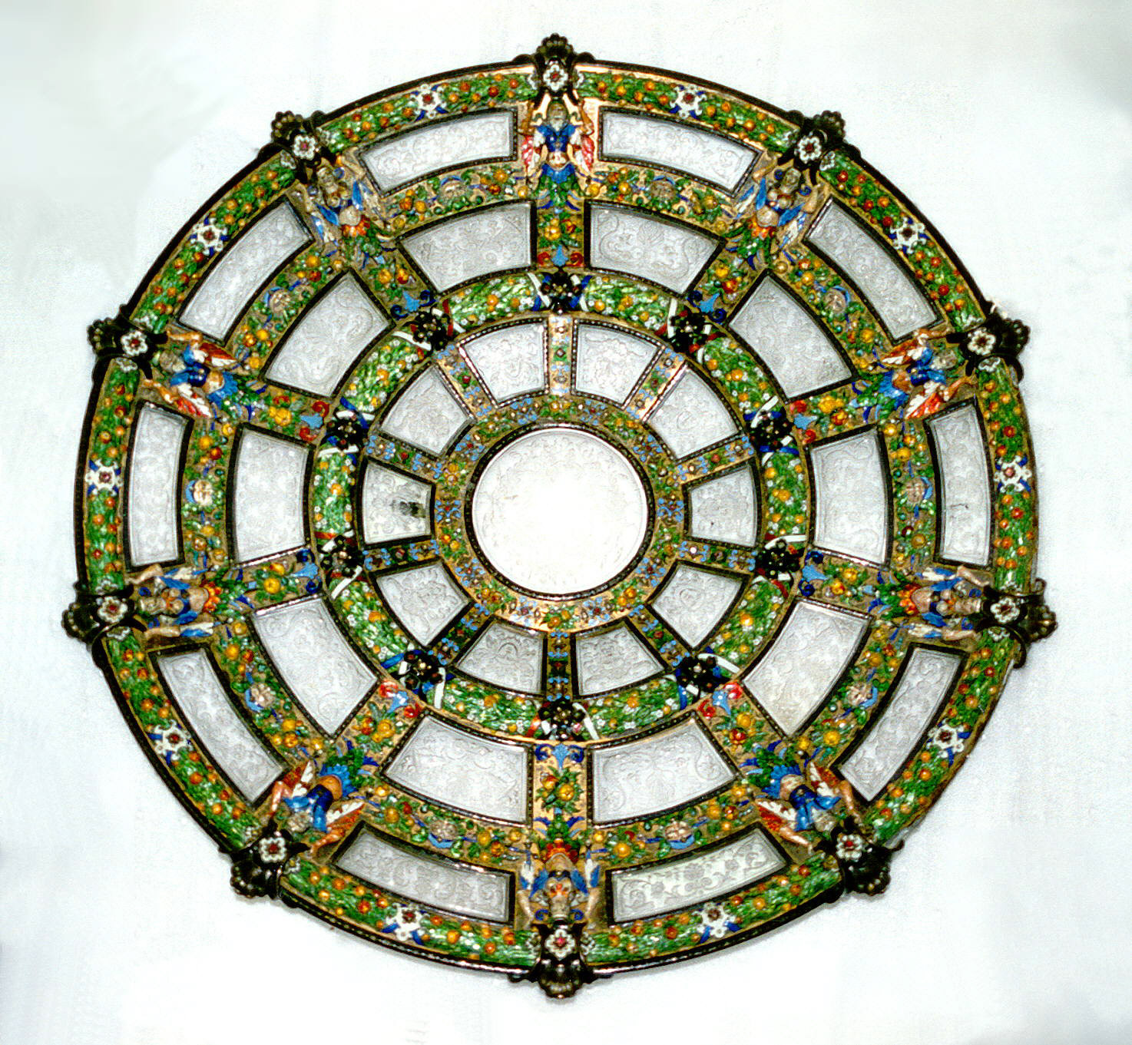
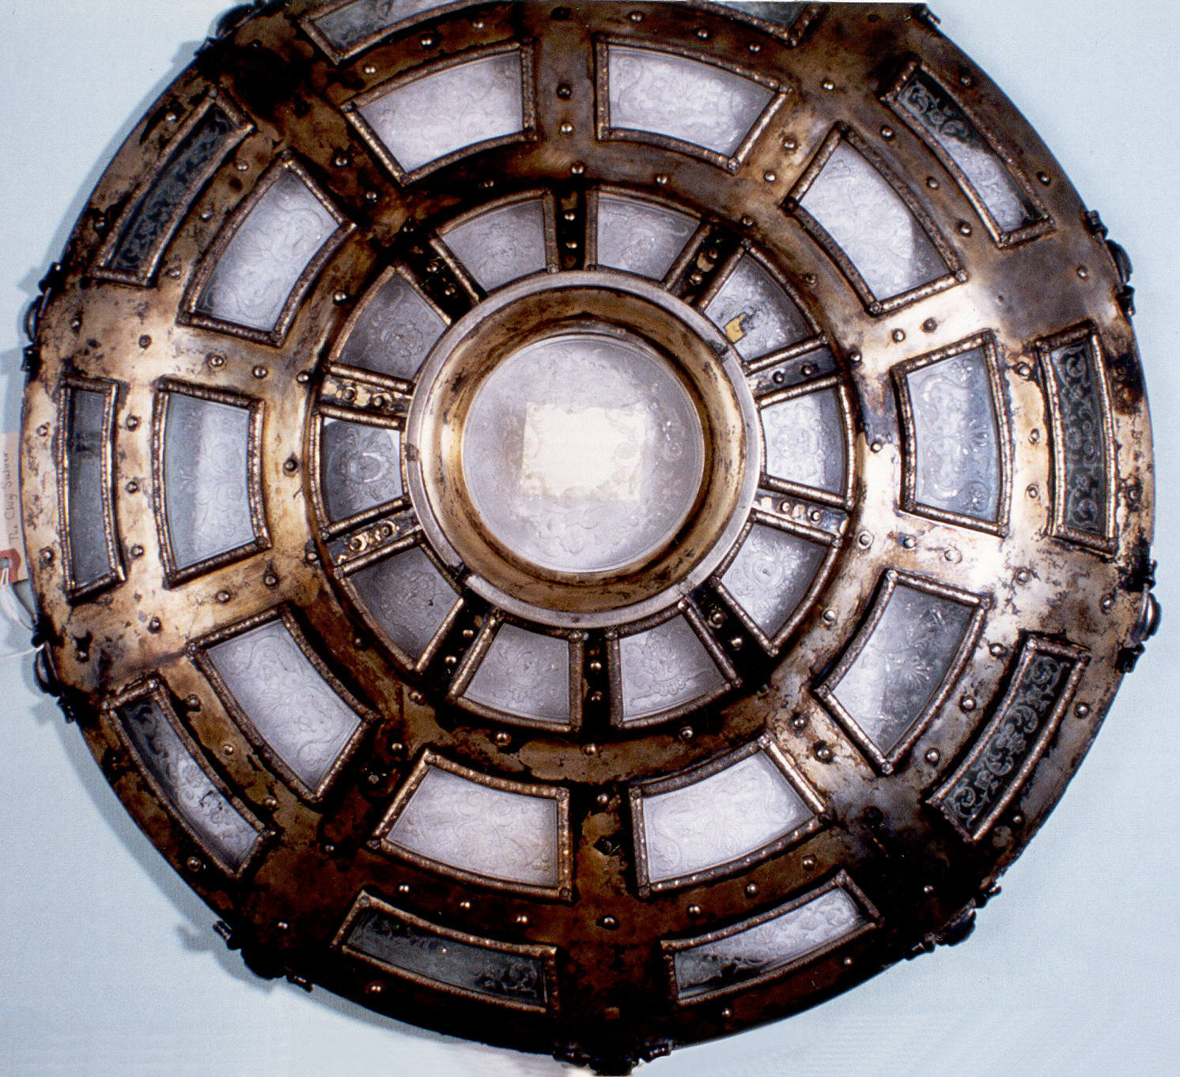
Attributed to: J. & L. Lobmeyr
Detail
Bottom
Dish (Austria), ca. 1870
glass, silver, gold, enamel, gem stones
56.5 cm diameter
(22 1/4 in.)
https://collection.cooperhewitt.org/objects/18649821/
Notes:
This is a good example of integrating materials and using these traditional materials in the same manner as Kilmt. Much of the functional work like this in the coming period tends to reflect the clean, minimal use of the material but in this instance the material are being exploited for their properties. Here glass in incorporated as engraved windows. Again a link with architecture too.

Slide 22
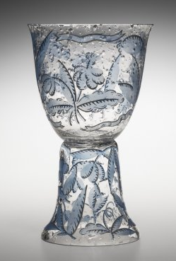
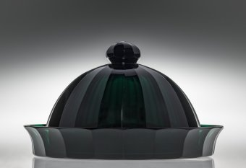
Josef Hoffmann
Dish w/ Lid
Mold blown, cut and polished glass
12.2 X 21.3cm
C1923
This work was made at Moser Crystal, Karlovy Vary (formerly Karlsbad)
https://www.cmog.org/artwork/lidded-dish
Vase with Blue Flowers
19.8cm x 11.7cm
Johannes Oertel & Co., Novy bo, CZ (formerly Haida)
1917
https://www.cmog.org/artwork/vase-blue-flowers
Notes:
Josef Hoffmann, is an incredible designer. From setting new standards in furniture and architecture, he is revered as an innovator in glass.
He is the leader and influential in to several movements; Vienna Secession, Wienerwerstatte, Werkbund and Bauhaus. His designs are still pertinent and appreciated today.
This vase is a an example of how Hoffmann understands materials. Although made during his time with the Wienrwerkstatte, it demonstrates the ideas in the Vienna Secession of which he had left with Koloman Moser and Kilmt in about 1905. Hoffmann and others left because of the constraints that other members were wanting to place on movement and the move back to fine art over applied art.
As we have seen Josef Hoffmann is one of the most important of the artists working at this time. He is pivotal in the changes and philosophies that are being developed. For the craftsman/artist and glassmaker, he is very important to bridging the aesthetics and elaborating on them, paving the way for the future.

Slide 23
Otto Prtuscher Designer
Dessert Glass
Blown, enameled & cut glass
8 × 5 5/8 × 5 5/8 in.
(20.32 × 14.29 × 14.29 cm)
Made by: Josef Meyr's Neffe
1816 – 1822
https://collections.dma.org/artwork/3240912
Notes:
You will see similar use of the material by Jodef Hoffmann and Adolf Beckert in the next section. In the next part we will also be discussing where these items are being made. While designed in Vienna, primarily, much of the work is created in Bohemia.

Slide 24
Weiner Werkstätte 1903-1832 These dates are approximate and may differ between sources.
Attributes:
Simple but dynamic lines
Ornament must be original not historical
Organic contrasted with geometric
Introduction of technology for purpose of quality, not all agree
Machine becomes an extension of the hand
Unifying all the arts and associated media
Brought all movements together under one roof
Founding members & Affiliates:
You will notice that these artists are also active or considered as part of other movements. Some listed below will be integral to the Vienna Secession
Josef Hoffmann
Koloman Moser
Joseph Olbrich
Peter Behrens (proto-modernism)
Henry van der Velde – founded the Kunstgewerbeschule, Weimar, Germany
Benrhard Pancock
Hermann Muthesius – founder of Werkbund, 1907
Werkbund members:
Josef Hoffmann, Koloman Moser, Joseph Olbrich, Richard Riemerschmid, Peter Behrens, Oswald Haerdtl
Michael Powolny
Leopold Bauer
Oswald Haerdtl
Adolf Beckert
“… we should always avoid the pompous and continually
strive towards a better material and a more accomplished
construction. After all our life, insofar as it can be
taken seriously, obtains dignity through simplicity, honesty
and purity…” Josef Hoffmann, 1901
https://www.lobmeyr.at/content/ww-artdeco/ww-artdeco2/
***Artists are listed with the associated firms. There will be repeats between firms. Links are in violet. ***
Notes:
The Wiener Werkstätte is an extension of the Vienna Secession. This was a response to other artists that were not holding to the ideas of the Vienna Secession. The Wiener Werkstätte created stronger bonds with the artist/designer and the manufacturers and craftsman, especially in glass. This was important because of the specialized knowledge needed for executing work in glass. This period held numerous innovations in process as well as aesthetics.

Slide 25
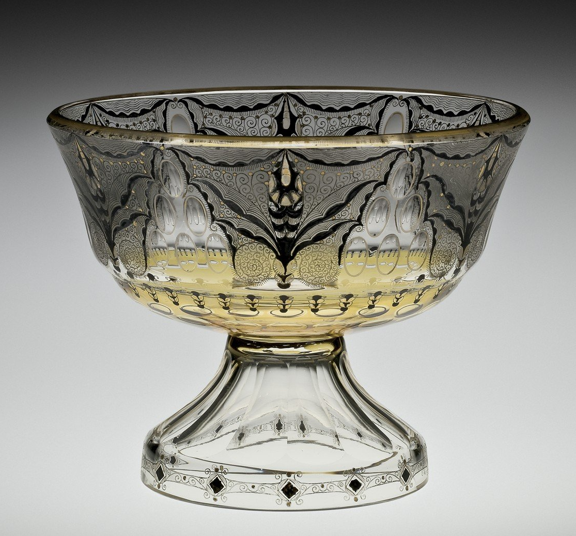
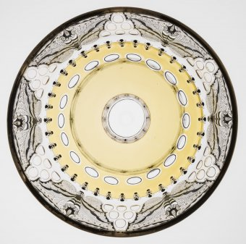
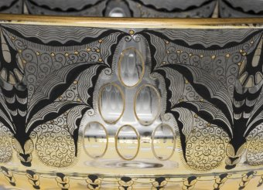
Adolf Beckert
Detail of bowl viewed from the top
Footed Bowl w/ Enamel Decoration
Mold blown, enameled & cut glass
14.6 X 18.8cm
C 1916
https://www.cmog.org/artwork/footed-bowl-enameled-decoration
Detail showing traditional decorative cuts combined with the enameling
Notes:
This is mold blown glass that has a yellow stain, black enamel and gold gilding. The foot and the bowl are made from separate molds and connected hot and later cut and polished. The clear oval shapes are called olive cuts. This work has many element that are distinct to the region that it was created. While designed by Beckert this was executed by the faculty and students at the Secondary School of Glassmaking - Kamenicky Senov, Czechia. This is recognized as the first and oldest glass school in the world.

Slide 26
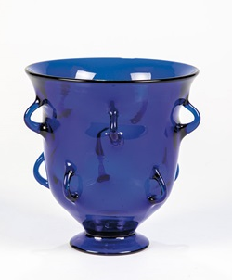
Michael Powolny (Austrian, 1871–1954)
Vase with Multiple Handles
Blown glass
14.4cm, X 13.7cm
1918
https://www.cmog.org/artwork/vase-multiple-handles
Notes:
Michael Powolny was a sculptor and designer that primarily worked in ceramics and later would design glass. He continued to work in glass and ceramics throughout his career. He and former school mate, Bertold Löffler founded Wiener Keramik (Vienna Ceramic) workshop.
Powolny sold work through the Wiener Werkstätte. Later he would execute designs in glass for J&L Lobmeyr and Johan Loetz Witwe. He also worked closely with Hoffmann and also worked with Deutche Werkbund
This work demonstrates his dedication to the aesthetics of the period. The clean line, refined and proportions form and maximizing the attributes of the material while bringing in his ceramics background which is seen in the multiple handles. The handles are an unusual addition and is not seen in other works. The handles appear to be pulled directly from the body of the vase as opposed to traditional methods of applying the handles with separate bits.

Slide 27
Firms/Factories & Schools Associated with the Vienna Secession & Wiener Werkstätte with the connected artists ***hyperlinks have been added***
Firms & Producers:
Lalique Crystal - René Lalique
Johann Loetz - https://www.loetz.com https://www.pask-klatovy.cz/lotz/historie.asp?lng=en
Josef Zahn & Co. – currently Cerva Behemia - https://www.cervabohemia.com/en/full-history/
J&L Lobmeyr - https://www.lobmeyr.at
Reidel - https://www.riedel.com/en-us
Moser Crystal - https://www.moser.com/our-story
Egermann - https://egermann.webnode.cz/en/
Preciosa - https://www.preciosa.com/en/history
Associated Schools
Kunstgewerbeschule Vienna - https://www.dieangewandte.at/jart/prj3/angewandte-2016/main.jart
The Glasgow School - https://www.mackintosh-architecture.gla.ac.uk/catalogue/name/?nid=BauLeo
Secondary School of Glassmaking - Kamenický Šenov (at this time the city is named Steinschönau)
http://www.czech-glass-school.com/school.html
Kunstgewerbeschule, Weimar, Germany – leads to the Bauhaus
Notes:
At this time the firms/factories and schools associated with the Wiener Werkstätte become even more important. As the connection between artist/designer and maker become more substantial the boundaries also start to dissolve. This is most apparent in those using or designing glass.
This also demonstrates how these are all connected and the work done in this time will be linked to future art and design movements. Please notice how the artist/designer are working with multiple firms and factories while keeping a good foothold in the educational institutions. For our purposes, we will be focusing on a few large stakeholders. There are numerous participants and it is difficult to present all.

Slide 28
Leading up to the Bauhuas
Other influential and associated movements of the time:
Jugenstil
Der Werkbund
Der Blaue Reiter
Die Brücke
De Stijl
Expressionism (especially German)
Cubism
Constructivism
Later from the ideas of the Bauhaus also comes Minimalism – a fundamental idea taught in the Bauhaus
Surrealism
Dadaism
Notes:
As we have seen so far many of these movements (or styles) have centered around similar fundamental elements. Namely they are all interested in the dissolution of barriers between the fine arts, crafts and associated mediums and architecture.
You will notice that several of these artists/designers are moving from one to the other to continue the pursuit of these fundamental ideas. As they do this, there is an attempt to formalize the practices and aesthetics through the formation of schools.
An interesting note here is that while Europe seems to have resolved this issue in contemporary time, to a certain extent, the artists and craftsman, especially in the faculty and students at the US universities still struggle with this idea of art versus craft and design.
At this time the “…isms” start to appear. There is something for everyone.

Slide 29
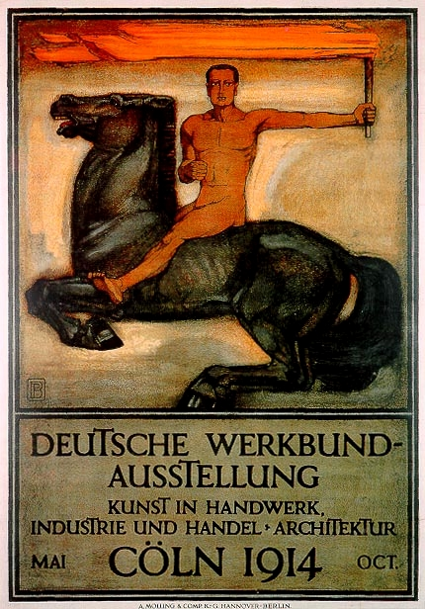
Deutscher Werkbund 1907-1934 / Reestablished in 1949 a foundation for the Bauhaus (pun intended) ***These dates are approximate and may differ between sources***
“...from sofa cushions to city-building”
https://www.deutscher-werkbund.de/wir-im-dwb/basic-information-in-english/
Attributes:
Simple refined forms
Ornaments are removed
The ability to mass produce designs is a focus
Introduction of technology for purpose of quality and precision
Machine becomes an extension of the hand
Still unifying all the arts and associated media
Establish partnership with designers/artists and architects with manufacturers
Exhibition Poster
Peter Behrens
1914
https://commons.wikimedia.org/wiki/File:Deutsche_Werkbund-Ausstellung_Kunst_in_Handwerk,_Industrie_und_Handel_Architektur_Köln_1914_Oct._Peter_Behrens_A._Molling_%26_Comp._KG_Hannover_Berlin.jpg
Notes:
The Deutscher Werkbund is more of a collective of artist/designers, architects and manufacturers. While it is happening at the same time as other movements such as the Wiener Werkstätte, the Werkbund becomes a realization of the ideas set forth the previous movement and put into action. This becomes the segue to the BAUHAUS and a foundation for an earlier discussed movement, The Jugendstil.
This started with 12 artists and 12 manufacturers

Slide 30
Deutscher Werkbund
Founding members & Affiliates:
You will notice that these artists are also active or considered as part of other movements.
Peter Behrens – Founding member, founding member of Vienna Secession, member of Wiener Werkstätte,. Ludwig Mies van der Rohe, Le Corbusier, Walter Gropius and Adolf Meyer all worked for Behrens.
Theodor Fischer - served as its first president of The Werkbund
Josef Hoffmann – (this guy is super busy) – founding member of Vienna Secession, Wiener Werkstätte
Max Laeuger
Hermann Muthesius – Founding member
Joseph Maria Olbrich – Founding member, founding member of Vienna Secession
Bruno Paul – Founding member
Richard Riemerschmid – Founding member, founding member of Wiener Werkstätte
Eliel Saarinen
Heinrich Tessenow
Ludwig Mies Van der Rohe - Architecture director, later director of Bauhaus
Henry van de Velde
Likoerglas (Liqueur Glass)
Richard Riemerschmid
Blown glass (while the description from CMOG does not mention, the cup is most likely mold blown and cut)
https://www.cmog.org/artwork/unknown-349

Slide 31
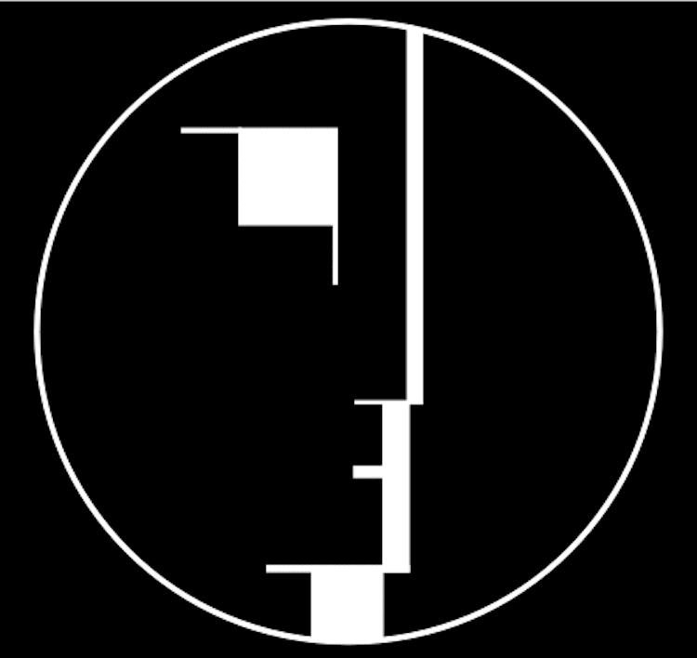
BAUHAUS Ideas, implementation
Overall ideas:
Reimagined the future
Rational, functional design
Integration of all fine & applied arts
Development of new academic processes and pedagogy
Form & function should be valued and used equally, however it does lead to form following function
Design should be about how we live, not about the user
Universal language of design – perfection of form to maximize utility
Close ties between school and industry
Less decoration and ornamentation, more form and function
Bauhaus Logo
Designed by: Oskar Schlemmer
1922
https://en.wikipedia.org/wiki/Bauhaus#/media/File:Bauhaus-Signet.svg
Notes:
As you will see, at this time, glass is still being produced with the ideas from the former movements we have been discussing. However, it is important to have the context. In the Bauhaus glass is used more in lighting and architecture and becomes more of an element of an overall purpose and composition. In this case they are very interested in the use of the material for it properties of transparency and translucency, which follows the Bauhaus philosophy.
Bahuas Locations
Weimar: This is the first location where Walter Gropius laid the groundwork for what would become known as the Bauhaus. His ideas were not fully realized until the move to Dessau.
Dessau: This is the location that most are familiar and where the movement found its greatest implementation. The Bauhaus was moved to here due to political differences and motivation.
Berlin: After the dissolution of the school in Dessau on September 30, 1932, the students and teachers relocated to an abandoned telephone factory in October of 1932. This was finally closed by the in 1933.

Slide 32
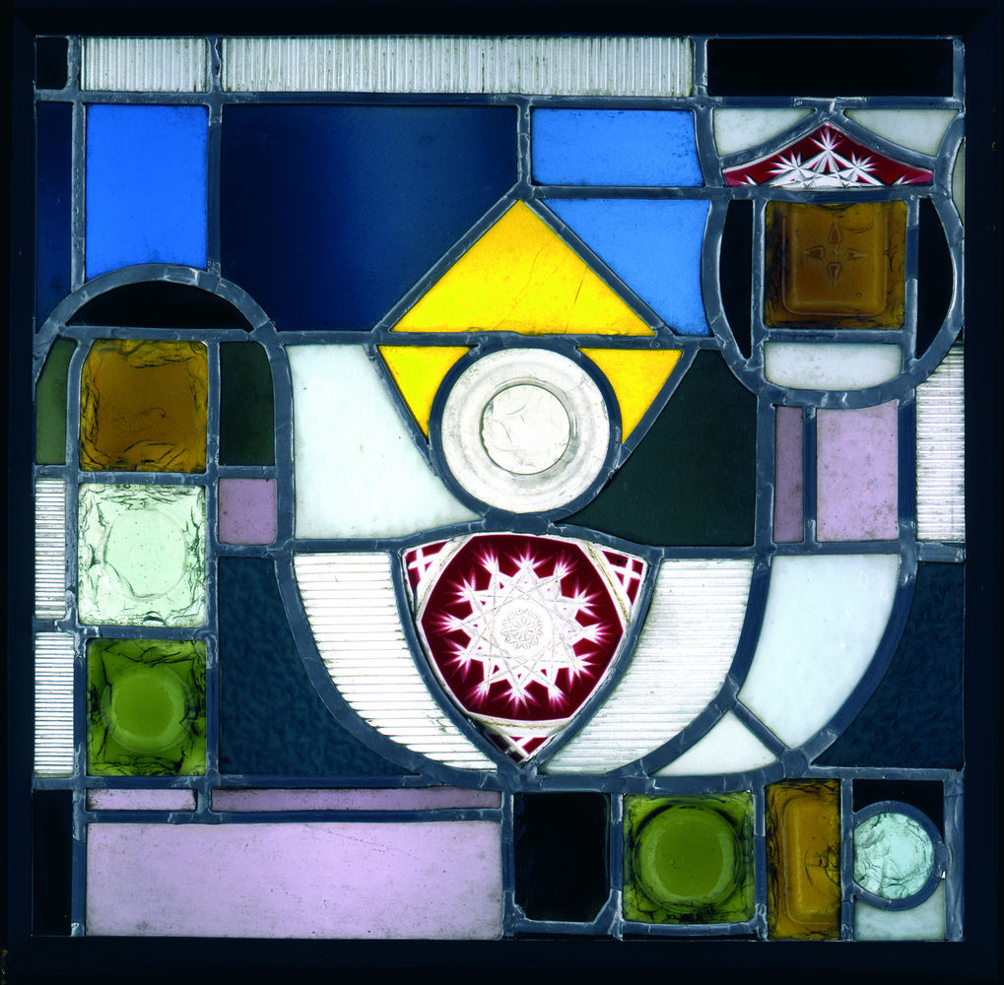
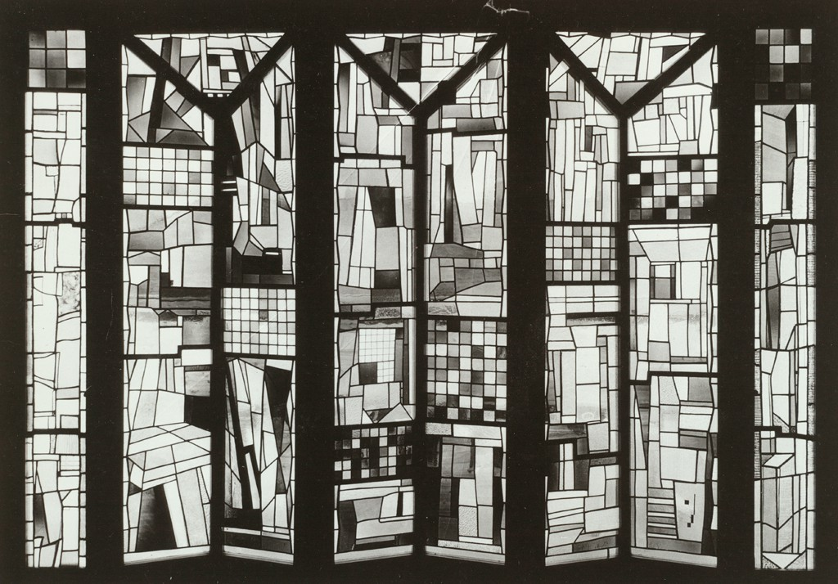
Josef Albers
Kaiserlich (Imperial)
Leaded glass
48”x49”x4” (122x124x11cm)
c1923
Stained glass windows for the Sommerfeld Residence,
Josef Albers
ca. 1920–1921
https://www.getty.edu/research/exhibitions_events/exhibitions/bauhaus/new_artist/body_spirit/architecture/
"Scherben im Gitterbild”
Shards in a Picture Grid, author: Josef Albers, 1921
Prototype for Sommerfeld House
https://www.bauhauskooperation.com/knowledge/the-bauhaus/works/glass-painting/shards-in-a-picture-grid/
Notes:
While Albers is known as a painter he did work extensively in stained glass. You can see he is influenced by the teachers at the Bauhaus and the external movements such as Constructivism.
https://issuu.com/artsfblog1/docs/glass_color_light_albers
The Sommerfeld Residence was designed by Walter Gropius and Adolf Meyer. This is a stained glass window, designed by Josef Albers, located on the interior of the house above the staircase. This is one of several works of various Bauhaus workshops on full view. Josef Albers was a student at this time. Albers’s design reflects the ornamental wood work carved by Joost Schmidt. These geometric carvings can be found throughout the house on the interior and exterior. Schmidt, a student colleague of Albers, would become the director of the sculpture workshop. These are examples of a return to the ideas from the Weiner Werkstätte. While the Bauhaus was more interested in clean design and less ornamentation, this is a move towards their other ideas of activating space and creating and environment or experience.
In this example Albers may be using remnants of glass from the factory or pieces that he had made for the process. He may have been utilizing materials that he has around him or has access. Across the top you can see the vertical line which would be typical architectural glass, it would be transluscent but you would not see a clear image. A couple of other examples are the red and clear elements in the top left corner and just below the center circle. Are cut in a method of rich cutting that is well known in Germany, where he is located and nearby in bohemia. The specific glass is similar to the red stain that was invented in Northern Bohemia and then cut through to revel the clear.

Slide 33
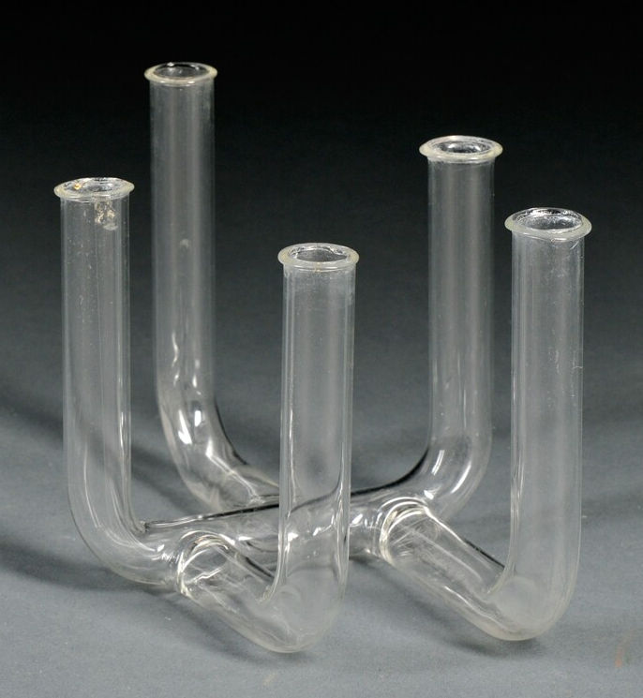
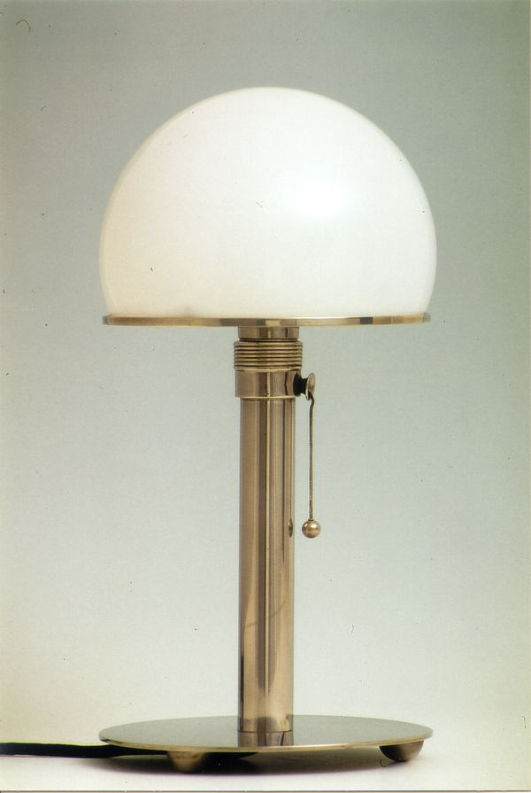
Wilhelm Wagenfeld
Vase or Bud Vase
Blown glass
4.5” X 7”
c1935-44
Executed at the Vereinigte Lausitzer Glaswerke, Germany, 1935-44
Skinner Auctioneers, Boston - https://www.liveauctioneers.com/item/11811210_302-wilhelm-wagenfeld-1900-1990-vase-hand-blown-g
WA24 Lamp (Metal Version)
Opalin glass and nickel plated steel
1924
production: Staatliches Bauhaus Weimar photo: Joachim Fliegner.
https://www.bauhauskooperation.com/knowledge/the-bauhaus/people/students/wilhelm-wagenfeld/
Notes:
This particular lamp has become an icon for the Bauhaus. Wagenfeld was trained as a metal worker and jeweler. He designed in many materials but is one of the noted students from the Bauhaus that did branch out. The example followed proportions and geometry specified by his teacher László Moholy-Nagy.
This vase is most likely made from recently developed borosilicate tubing. This can be identified by the connection points along the central tube. Borosilicate was a recently invented in the late 19th century. This kind glass of glass is resistant to thermal stress, aka thermal shock. It can heat and cool quickly. Because of this material property, the connections mentioned can easily be done without breaking t he rest of the glass. This is used for many things but here the relationship would be to the laboratory and industry.

Slide 34
Studio Glass
Czech Developments
Notes:
Development of glass objects and sculptures to utilize elements of cubism, geometry, continuing with the philosophies of the Bahuas, designing for utility and purpose. Where again the consideration of material is prime. Later with the more sculptural work, voids and thickness contribute to the movement of light to create changes in density. This has the potential to accentuate form and multiply space. This effect can create forms within forms and change as the viewer moves around work.
In this new time under communism many things changed and thankfully there was an investment in glass. While many artists still worked as designers for factories the freelance studio glass blossomed and new aesthetics were evolving as well as processes. The specialized schools were reinvested and some new arose. While other part of the world moved toward factory production the Czechoslovak region continued with the factory but broadened their interest as the mold melted glass and quality of materials and exploration increased.
This new direction was partially initiated by professors Josef Kaplicky and Karel Stipl.

Slide 35
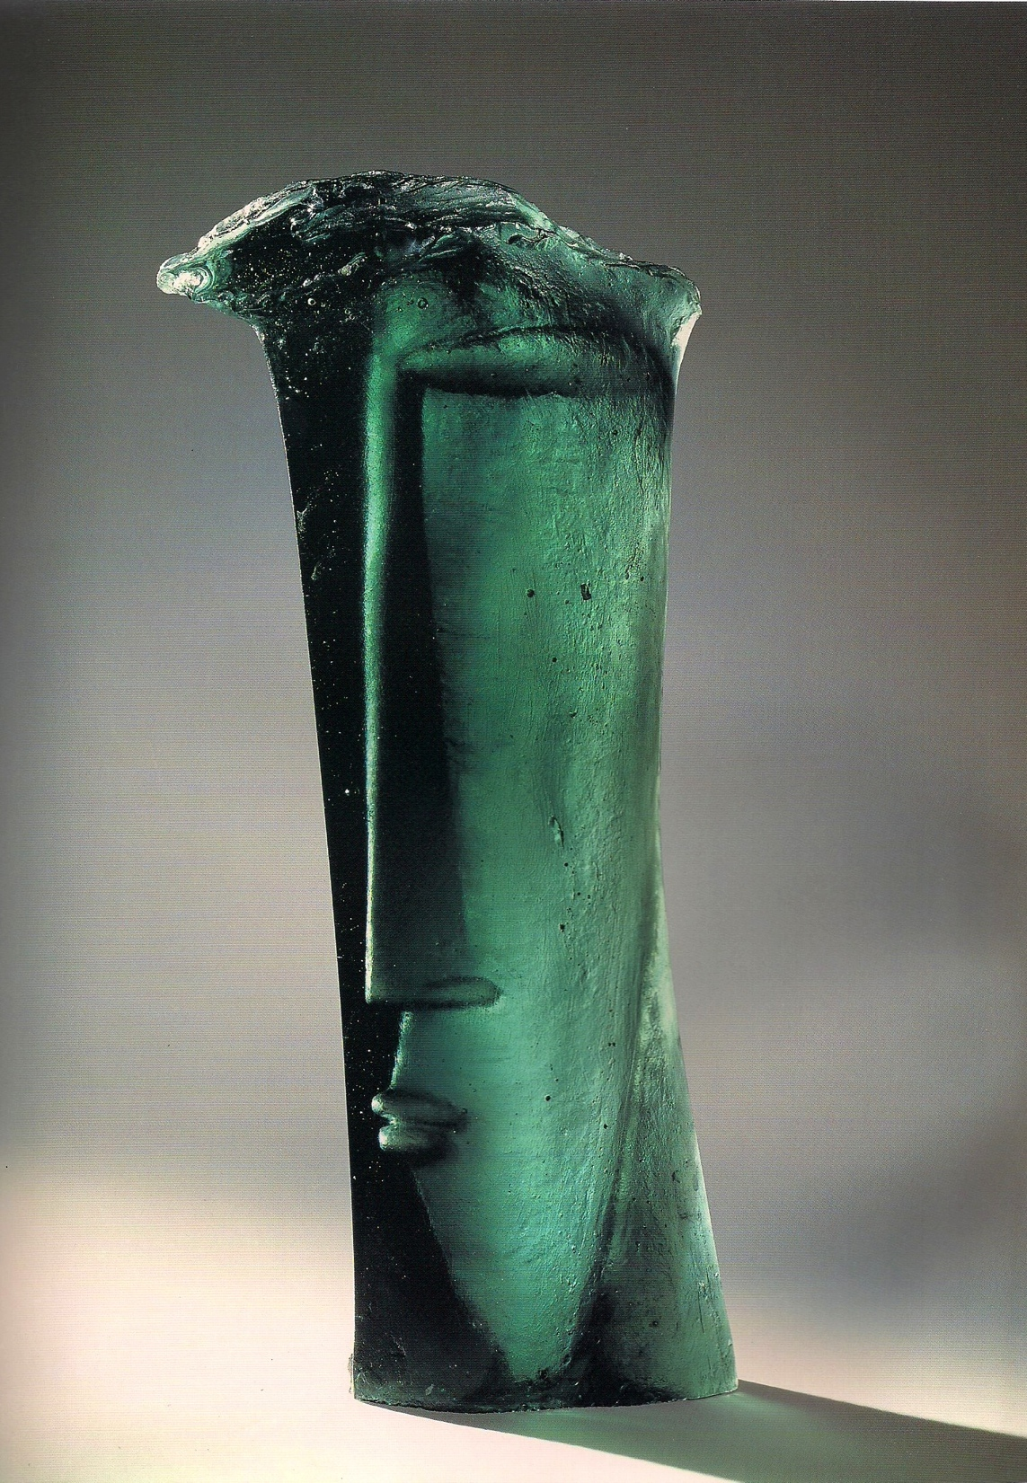
Stanislav Libenský & Jaroslava Brychtová
Head Bowl 4.5 x 12 inches (11 x 30 cm) 1955-56
Photo: Gabriel Urbánek,
source: www.upm.cz
https://www.prague.eu/en/event/21933/pleiad-of-glass-19462019
Head I 14 x 6.75 inches (35.5 x 17 cm) 1957-1958
https://www.cmog.org/artwork/head-i
Notes:
These two works are the beginning of a portion of the modern aesthetic. Respect for the object, the material and form rose as well as a strong foundation in the fine arts. A new version of Czech glass was to rise with these innitators.

Slide 36
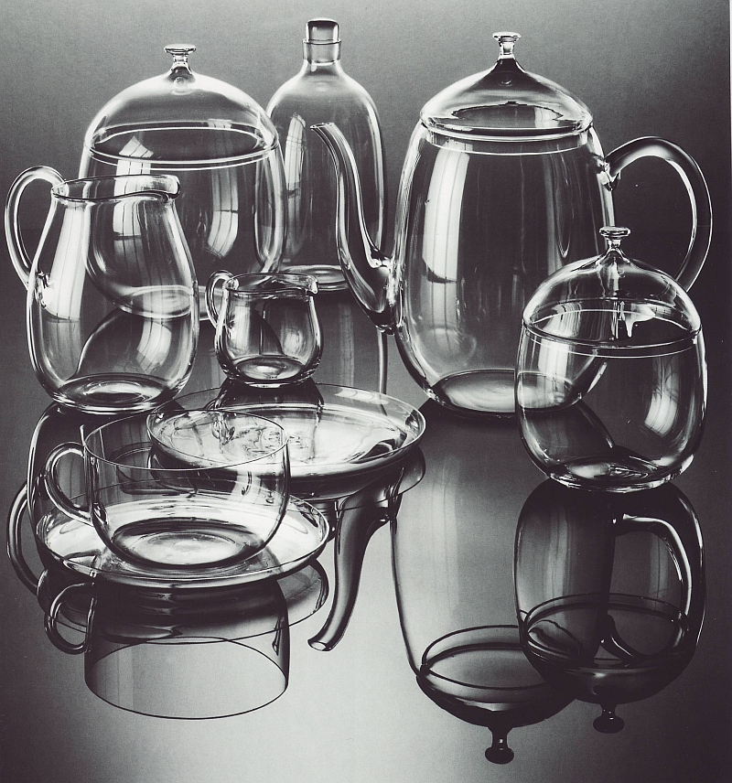
Stanislav Libenský
Tea service
heat resistant glass
1949-50
Novy bor
Legend of Bohemian Glass, Langhamer p164
Notes:
In 1948, he returned to the Academy of Arts, Architecture and Design in Prague to the studio of applied painting and art work in the glass of Professor Kaplický. UMPRUM has meanwhile become a university. Libenský graduated here in 1950. After several years of working in Borské atelier, he left for Železný Brod, where he became the school principal at the age of 33. He worked here until 1963, when he transferred to the University of Academy of Arts, Architecture and Design in Prague as a professor.

Slide 37
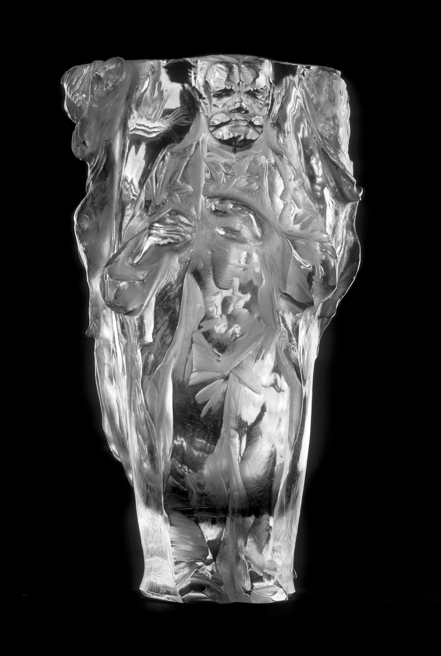
René Roubíček
Antonín Dvořák
Mold blown , cut and engraved glass
23,5 cm.
Made at Sklářská škola v K. Šenově 1946
Foto Gabriel Urbánek
https://www.upm.cz/rene-roubicek-99-vyroci-narozeni/
Notes:
Born in 1922. He studied in the studio of Jaroslav Holeček at the Academy of Arts, Architecture and Design in Prague from 1940 to 1944 and in the studio of Josef Kaplický in 1950. From 1945 to 1952 he was a teacher at the glass school in K. Šenov. He headed the cut glass department here. After the school closed in 1952 (it was reopened in 1957), he worked briefly at the glass school in N. Bor. Then he became the leading artist of the Borský glass studios from 1955 to 1965. He coined the motto that "Sko is the art of today". He started a new era in cut glass in Kamenický Šenov. He has also dealt with metallurgical glass and realizations in architecture all his life.

Slide 38
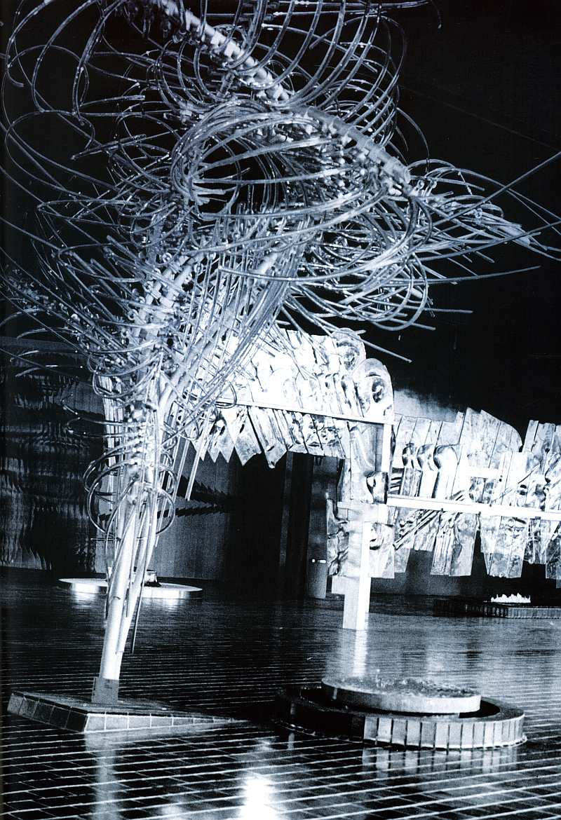
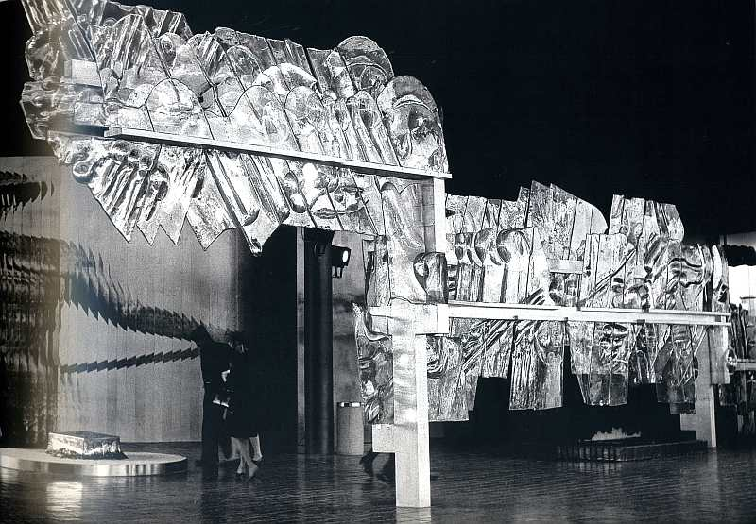
René Roubíček– Stanislav Libenský
Sculpture Cloud
René Roubíček
hot sculpted glass
Dimesnions variable
1970
River of Life
Stanislav Libenský
mold melted cast glass
Dimesnions variable
19790
From EXPO 70 – Osaka, Japan
Images provided by Frantisek Janak
Notes:
Sculpture Cloud and River of Life.

Slide 39
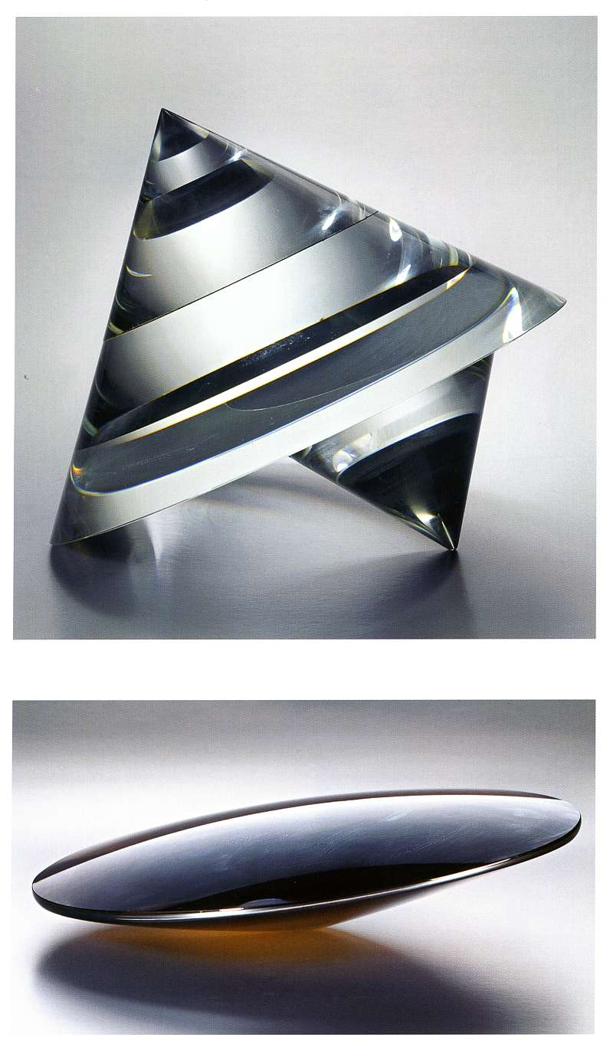
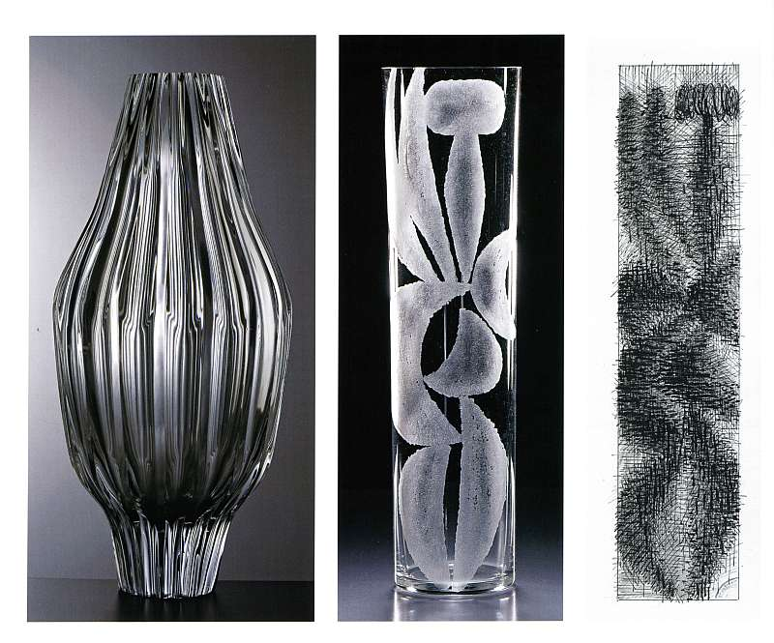
Václav Cígler
1959, 1964, 1961
1976,1977
Images provided by Frantisek Janak

Slide 40
Contemporary Glass and what led to it
Notes:
Much of what we think about as contemporary glass stems from the American Studio Glass Movement. Leading up to this, great work was made all over Europe.
I would like you to think about the attributes from the movements we have discussed-up to this point-and how the American Studio Glass Movement has embodied many of these attributes.
After the vibrant movements we discussed, glass takes on some new ideas and ways of working. Regional development of factories and the glass industry result in new ways of thinking about the material.

Slide 41
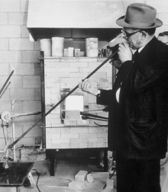
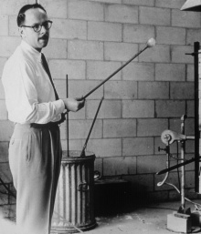
The Birth of a Movement
The American Studio Glass Movement was started with two workshops in Toledo, Ohio, in March and June 1962.
Dominic Labino at 1962 Toledo Workshop
https://www.cmog.org/article/founders-american-studio-glass-dominick-labino
Harvey Littleton at 1962 Toledo Workshop
https://www.cmog.org/article/harvey-k-littleton-and-american-studio-glass-movement
Notes:
The American Studio Glass Movement was started with two workshops in Toledo, Ohio, in March and June 1962. These workshops were created by Harvey Littleton and Dominic Labino with the cooperation of Otto Wittman, Director of the Toledo Museum of Art agreeing to host. Littleton brought his background in ceramics and his connection to glass. Dominic Labino brought his knowledge of glass science, and together they taught the first workshops in glass.
The story goes that on the last day the workshop, a glassblower from the Libby factory named Harvey Leafgreen, showed up and actually taught them some methods of working the glass.
This first workshop embodied the primary and related elements of the previous movements: the collaboration of artist, scientist, engineer, industry, craftsman and an underlying desire to make work that embraced the attributes of the material.

Slide 42
Harvey K. Littleton
“Eye”
Blown, cut & polished glass
1969
Varied Dimensions:
Overall H: 14.7 cm, W: 24.2 cm, D: 14.3 cm
https://www.cmog.org/artwork/eye?search=collection%3A4cda763d3eba7ca916a27745af6998f6&page=15
Notes:
Littleton was raised around glass. Growing up in Corning, NY, his father, Dr. Jesse T. Littelton was the first physicist hired for the newly founded research laboratory, developing such things as Pyrex.
Harvey was educated as an industrial designer and later turned to ceramics receiving his MFA from Cranbrook in 1951 and became faculty at the University of Wisconsin, Madison. This would become the first glass program in the country.
As Littleton began to build interest from other artists his interest grew even greater. He then started reaching out to those other artists and glassmakers from around the world. He visited Italy and built relationships that others such as Chihuly, Marquis, Moore and others would utilize and strengthen. Later, this exchange created the foundation of our glass blowing methods. Littleton found connection in Germany as well with Erwin Eisch.

Slide 43
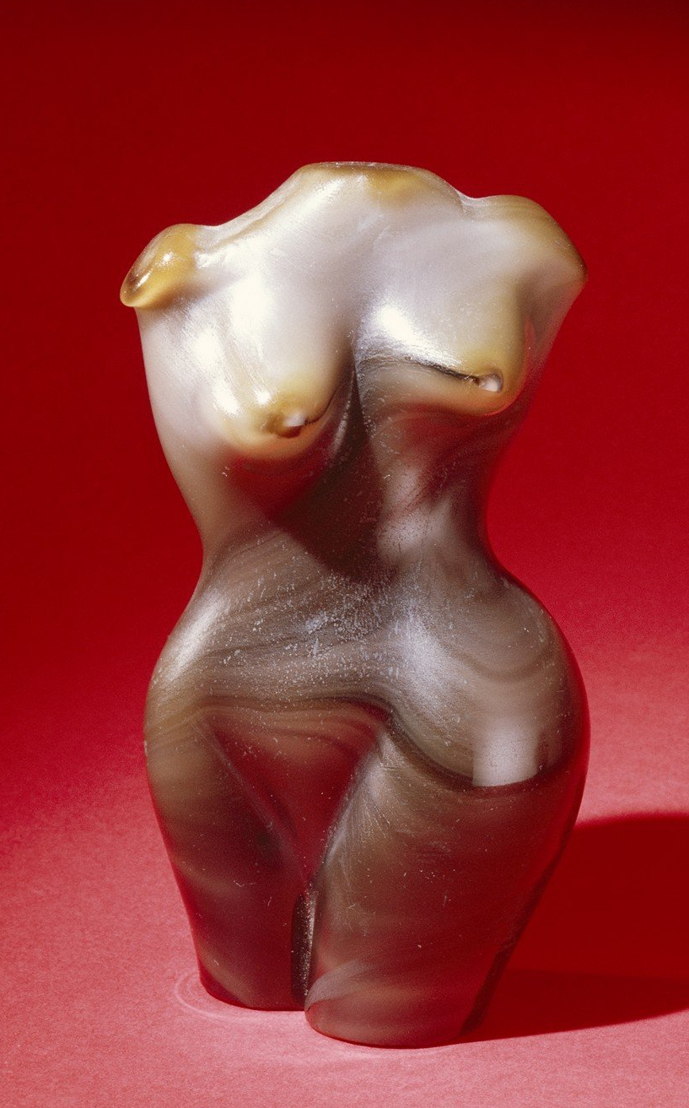
Dominick Labino
“Torso”
14.7cm
Blown, hot sculpted glass
1966
https://www.cmog.org/artwork/torso?search=collection%3Ada4095b097b5a6d6d3a57e5f6d35a123&page=10
“Emergence Four Stage”
Blown, hot sculpted glass
22.3 cm X 15.8 cm X 6.16 cm
1975
https://www.cmog.org/artwork/emergence-four-stage
Notes:
Labino is credited with two significant things for the American Studio Glass Movement; creation of the formula for the glass (Spruce Pine 87) and the design of the studio day tank. A small glass furnace that could melt glass in about a day and be easy to use and work from.
Labino was a scientist and artist . He has many other claims holding over 90 patents for glass technology.
”Emergence four-stage” is probably Labino’s most popular work. The “Torso” is an earlier piece that I think most are not as familiar

Slide 44
Littleton’s Students
This is a selection of Littleton’s former students
Dale Chihuly – started glass program at Rhode Island School of Design, founded pilchick glass school
Marvin Lipofsky – Started glass program at University of California Berkley and the California College of Arts & Crafts
Fritz Dreisbach – artist educator & historian, founding member of the Glass Art Society
Audrey Handler – artist, educator
Tom McGlauchlin – artist educator, attended first workshop, introduced second university class at the University of Iowa, June 1964
Sam Herman – artist educator
Joan Byrd – artist, educator
Henry Halem – started program at Kent State University, Kent, Ohio, founding member and first president of the Glass Art Society
Michael Taylor – artist, educator writer, head of the glass program at Rochester Institute of Technology, School of American Crafts, founding member of the Glass Art Society
Cristopher Reis – founded the glass program at the University of Ohio, Columbus, Artist in Residence at Schott in Duryea, Pennsylvania

Slide 45
Dale Chihuly
Silvered Rose Ikebana with Silver Stem and Yellow Flower
3 x 55 x 25”
2012
https://www.chihuly.com/work/ikebana
Rotolo 70
Hot sculpted glass
39 x 20 x 18”
2019
https://www.chihuly.com/work/rotolo
Notes:
Dale Chihuly is probably one of the most significant and important glass artists in history. His impact on the world community of glassmaker is tremendous. He has been a driving force for the expansion of the American Studio Glass Movement to become a world wide movement. Chihuly was cooperating and bringing artists from other countries to the USA since the 1970’s. He is a great example of bringing talents and technology together. Chihuly has worked with Italian Masters, bringing them to the USA and creating what is know as the “Northwest Style” of glassblowing and I would extend this contribution to glassmaking in general. The overall concept of this is teamwork. In what is now one of the largest centers of glassmaking in the world, Seattle, the common thought is, “it is all about the idea, whatever it takes.”
The work to the right is one of Chihuly’s latest endeavors. This work took a few years of research and development with many failures, requiring a team of glassblowers to make.

Slide 46
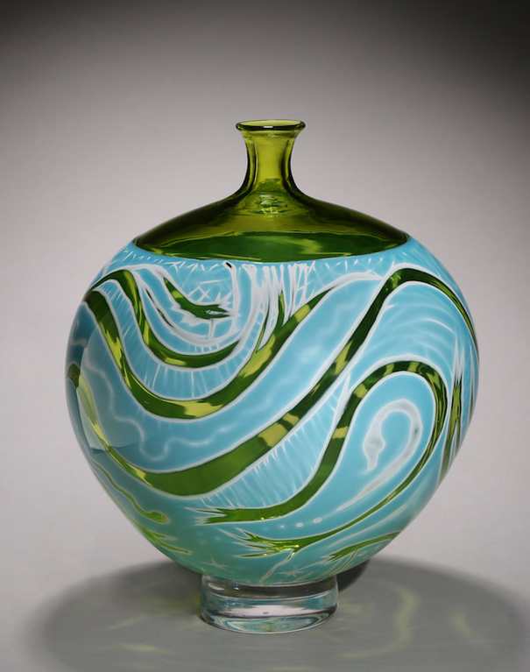
Fritz Dreisbach
Portrait of Fritz
Print from Glass Plate Engraving by Frantisek Janak
https://fritzdreisbach.com/roadwork/
Commemorative Pokal Celebrating the 30th Anniversary of the 1962 Toledo Glass Workshops and Fritz Dreisbach's 30 Years of Working with Glass
Designed by Fritz Dreisbach
Made by: Frtiz Dreisbach & Lark Dalton @ Pilchuck Glass School
Blown and engraved glass
54.8 cm; Rim Diam: 16.2 cm
1993
https://www.cmog.org/artwork/commemorative-pokal-celebrating-30th-anniversary-1962-toledo-glass-workshops-and-fritz?image=5
Cameo Series
Cut and engraved grail, blown glass
Dimensions not available
C2016
https://fritzdreisbach.com/gallery/cameos/
Notes:
Fritz Dreisbach is recognized as one of the great educators and now historians of glassmaking and the American Studio Glass Movement. Known as the Johnny Apple Seed of Glass, he spread the excitement of the material world wide. In the 70’s and 80’s artists like Dreisbach, Dick Marquis and Paul Marioni toured around teaching what the called, “The Road Show.” They were not only teaching private artists and university students but also entering the factory and teaching the factory workers new approaches to the material.
In Fritz’s work, he brings together multiple processes and historical context with a whimsey and excitement that gets a little lost in the esoteric discussions happening today in glass where concepts are hard to relate to the work without a lengthy explanation where this excitement from the founders gets lost and is missing.

Slide 47
Michael taylor
Helix
fused, optical glass
28h x 28w x 12d inches
2012
Notes:
Michael’s work is based on based on scientific principles and works like this are a discussion on great constructivist artists. While the title says this glass is fused optic it is actually chemically bonded using a high tech epoxies and colorants which gives the red color in the center of the work.
Michael Taylor is one of the artists in the beginning of the American Studio Glass Movement. He is one of the founders of the Glass Art Society and is recognized as one of the great educators. Michael has produced a large amount of the leading glass artists recognized in the industry today.
He is known for working with optic glass, producing great sculptures that embody the unique properties of the material. He brings together science, philosophy, history and aesthetic. Through his work, he has gained the reputation as a researcher, academic, philosopher and writer.

Slide 48
Christopher Ries
Desert Flower
Dimensions not available but these works can be up to 36” in height
Cut, ground, and polished optical crystal
Photograph © James Kane
Notes:
Christopher Reis is a pioneer in the American Studio Glass Movement. While others were using optical glass, he had the unique opportunity of becoming the Artist in Residence at Schott Crystal in Duryea, PA. With this material, Ries has continued to make work that embraces the unique quality of glass as he approaches with the perspective as a philosopher, sculptor, engineer and innovator.
Reis had worked with Harvey Littleton in the early years and later started the first glass program at Ohio State in Columbus with only his BFA degree. This is nearly unheard of.
In this work you can see the exterior of the form and then the interior activation. Ries is one of handful that follow in this philosophy of glass having a fifth dimension, which is the interior space. As you move around the work the composition is constantly changing and responding to you movement. This is an elegant design physically but also technically. In the right you will see a crease. In this crease are two cut made with a very thin blade that counter across one another. With those two cuts, which are actually very small and minimal, you get the composition on the interior that is made from and understanding of placement and mirror mad by the polished flat surfaces

Slide 49
Paul MArioni
Jesus Christ
cast glass, enamel, mirror, copper
5"h x 12"w x 10"d
https://www.artsy.net/artwork/paul-marioni-jesus-christ
Notes:
Paul Marioni is one of the most noted artists in the American Studio Glass Movement. He is from a family of artists with brothers Tom and Joseph rising as substantial artists as well as his, son Dante Marioni and daughter Marina Marioni.
Paul is another that is recognized as a great educator and spreader of the glass enthusiasm. Paul did not begin working with glass in the same way as others. He cam to the material as an artist and then became a glassmaker. Recognized as an innovator and a surrealist, he has brought new thought and aesthetics in his 30+ years career.
Paul is also noted for introducing sandcasting as process for glass. He and Bertil Vallien where exploring this at the same time, but the first two.
The work presented here shows Paul’s whimsey. He is very interested in his personal influences and those from his experiences of living in Mexico. This work is kiln cast, then it is cut and refined. Then the work is fired again to slump it and get the curve while fire polishing the surface and firing the enamels. Sometimes the enamels are done in a third firing. Then you can see he has added mirrors to the eyes and a copper ban of nails.

Slide 50
Mark Peiser
Section One, Veils
Blown glass
56.6 X 27.9 X 27.9
2009
https://www.cmog.org/artwork/section-one-veils
Notes:
Peiser is an innovator, scientist (not formally)and artist. He is one of the founders of the Glass Art Society. His work embraces science in many aspects. The work here is from the “Palomar Series” which references the Palomar Lenses or Mirror. He also formulates and melts his own glass creating this unique color.

Slide 51
Charles Parriott
Execution
Engraved, polished glass
10.5” X 5” X 1.
https://www.travergallery.com/artists/charlie-parriott/5”
Notes:
By those in the know and their finger on the pulse of glass around the world, Charles Parrtiott is recognized as one of the greatest innovators, collaborator and facilitators. Charlie has worked close with such artists as Stanislav Libensky & Jaroslava Brychtova, Dale Chihuly and Preston Singletary, among many others. He has helped make their work possible and seen it through to existence. He would coordinate manage and was the colorist and R&D managing consultant for Chihuly for many years. With Chihuly, they brought the Libenskys to Pilchick and introduced Czech glass to the broader community during the communist period. Charlie has continued working in the Czechia where he now facilitates the creation of Preston Singeltary’s work between Reichenbach, Germany and the glass makers of Zelezny Brod, Czechia.
In resent times Charlie has been making work collaboratively like the example here with such artists as Jaraoslav (Jara) Sara. At the same time he is coordinating projects for the largest produced functional wine and vodka bottles – see link below – which are in the Guinness Book of World Records.
Article: https://www.radio.cz/en/section/curraffrs/all-hail-maximus-the-worlds-largest-bottle-of-wine
Video: https://www.youtube.com/watch?v=lL1uXgznT6

Slide 52
Select List of Contemporary Artists Using Glass
Sarah Sze
Dan Graham
Richard Jackson (LA artists)
Mike Kelley
Richard Artschwager
Kiki Smith
Maya Linn
Luke Jerram
Mark Dion
Robert Morris
Felix Gonzales Torres
Corban Walker
Fred Wilson

Slide 53
Links to my current body of work
The man who speaks with primordial images speaks with a thousand tongues … This is the secret of effective art.
C.G. Jung, Man and His Symbols
Notes:
The next few slides will demonstrate how I am currently translating these ideas and principles into my body of work. The process has taken some time to derive the lineage and make the connections. With all these works the important aspects revolve around concise use of line, the exploration and embellishment of the material, and a composition that is harmonious using juxtaposing elements. The refinement of the material lends to compositional elements with the addition of traditional glass cutting décor that is being presented in a new format.

Slide 54
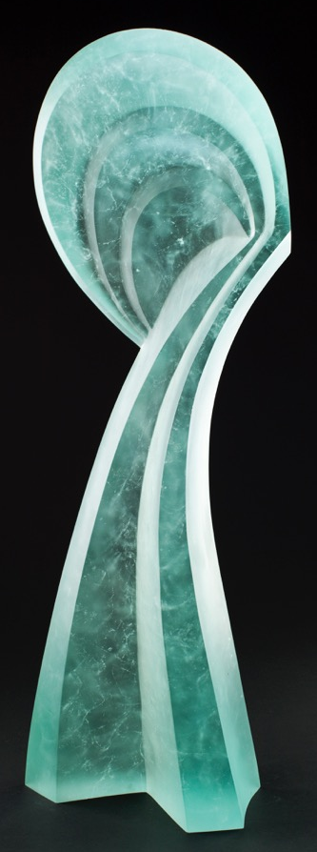
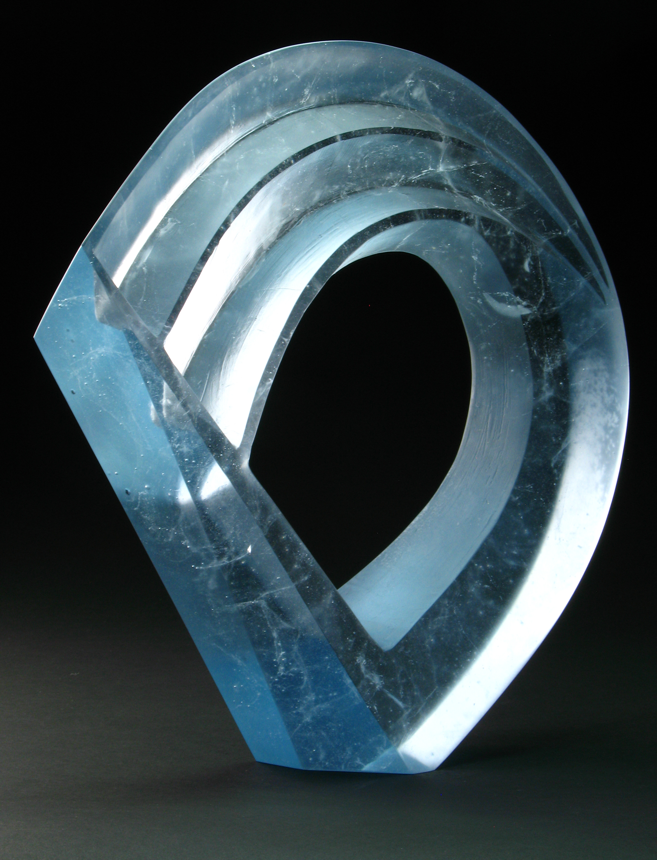
Indigo Ascent mold melted, cut & polishedlass 15”x14”x3”
2014
Blue Blossom Passage mold melted, cut & polished glass 31” x 10.5” x 6”
2014
Notes:
This current work searches for the simplicity in from while creating a dynamic composition. The repetition of linear elements is combines well with the use of light and the overall form.

Slide 55
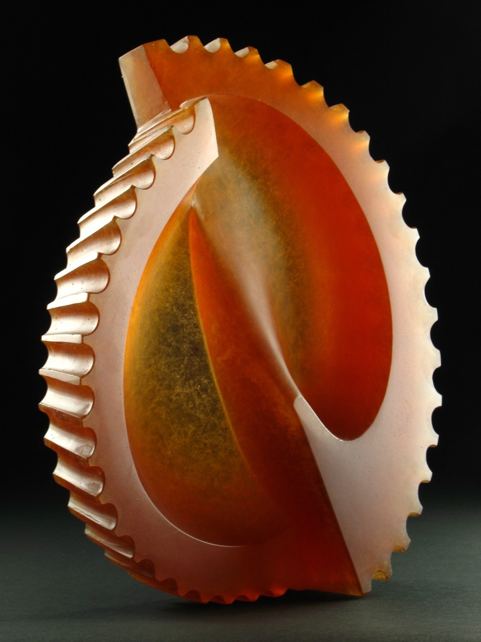
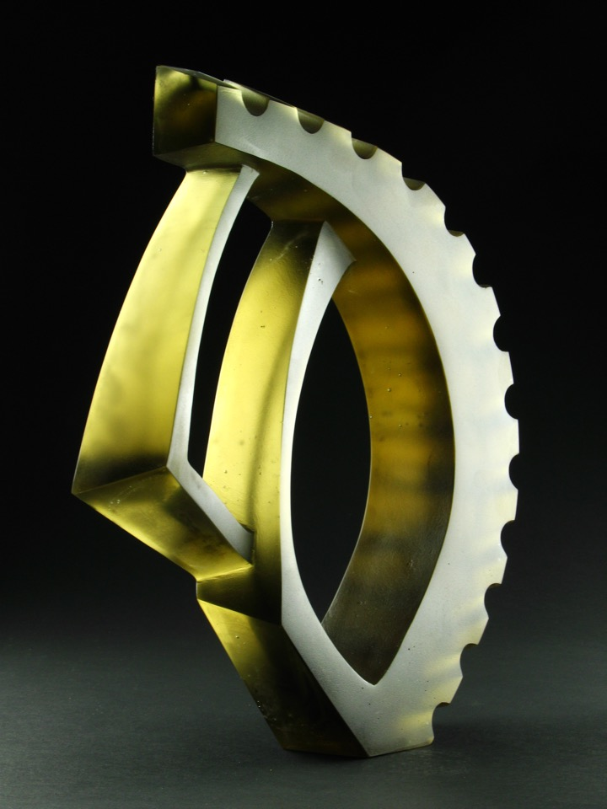
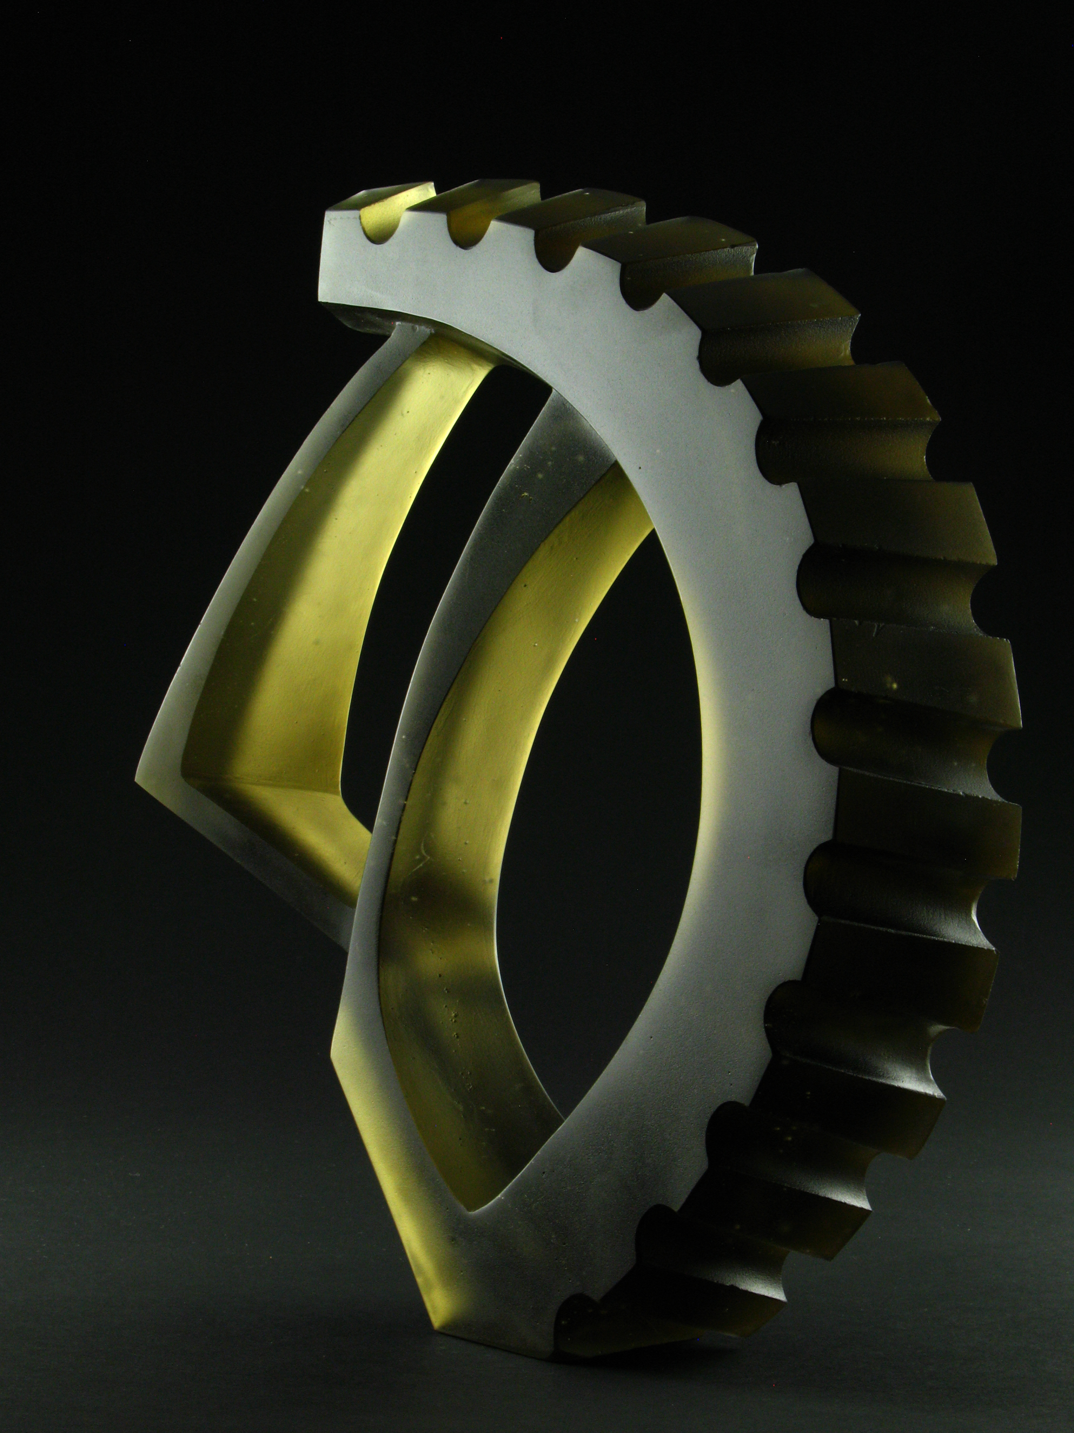
Buttress Sprocket mold melted and cut glass 15” x 14” x 3”
2015
Crescent Sprocket mold melted, cut & polished glass 16.5” x 14” x 4”
2016
Notes:
Simplicity of the design and working with the composition that the material offers.

Slide 56
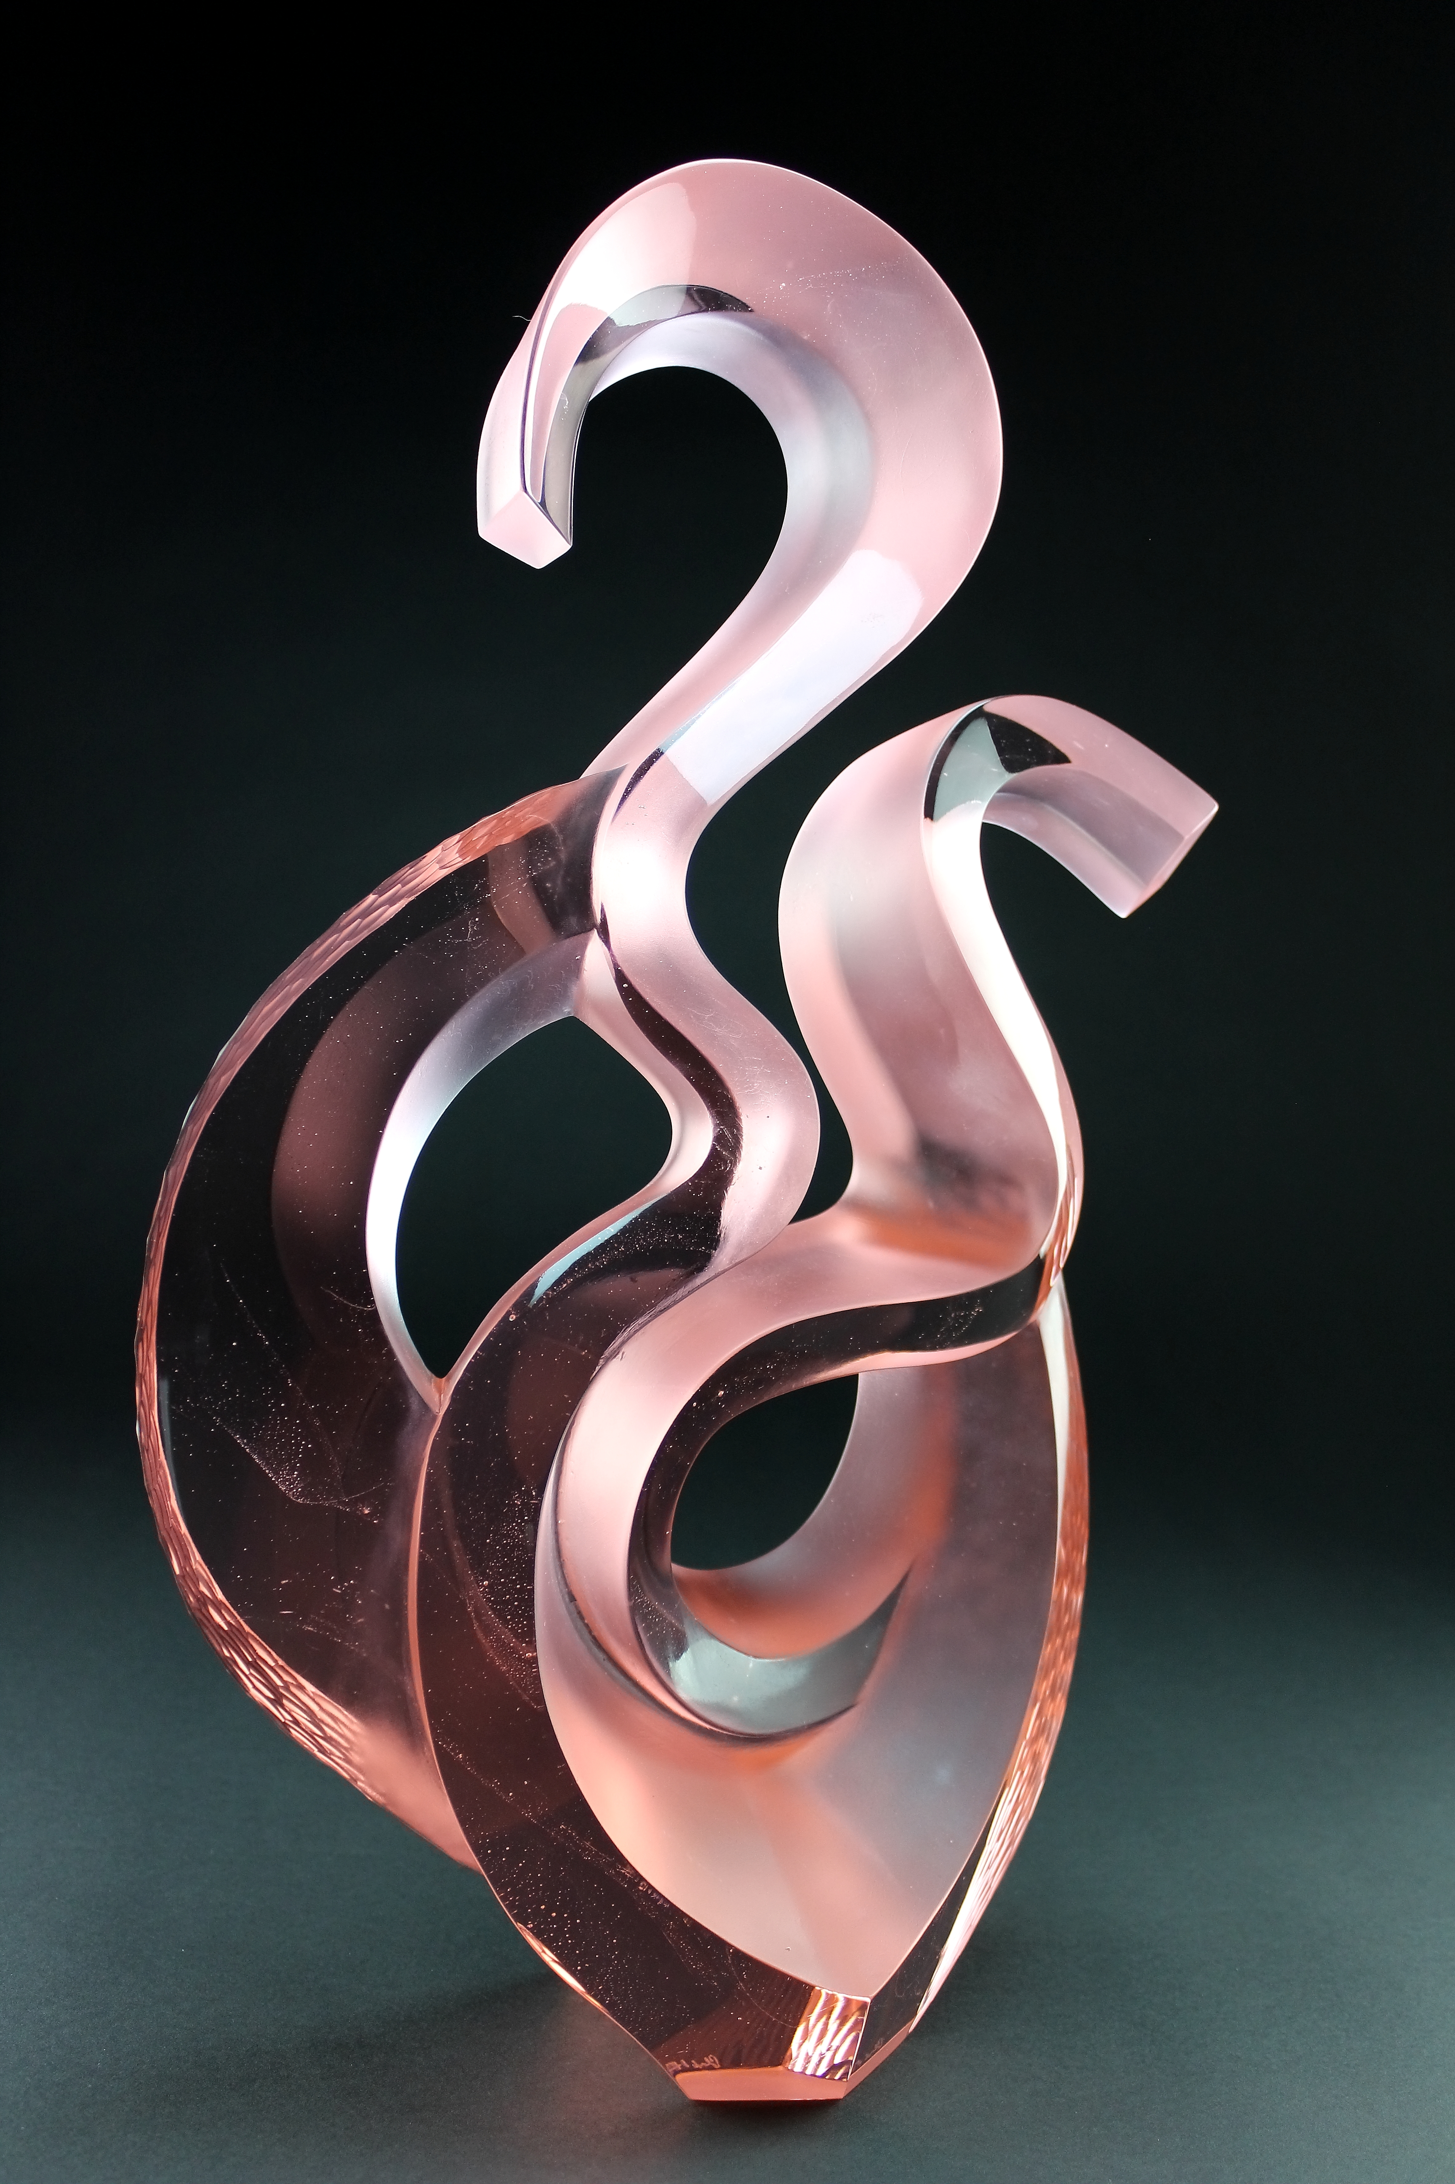
Bi-gestural in Salmon mold melted, cut & polished glass 19" x 13" x 4.5"
2020
Bicircular Gesture in Violet mold melted, cut & polished glass 22" x 13" x 4"
2020
Notes:
As I made these works I found the connections with the linear elements of nouveau and deco while remaining within the ideas of embracing and using the properties of the materials to push the visual qualities and composition

Slide 57
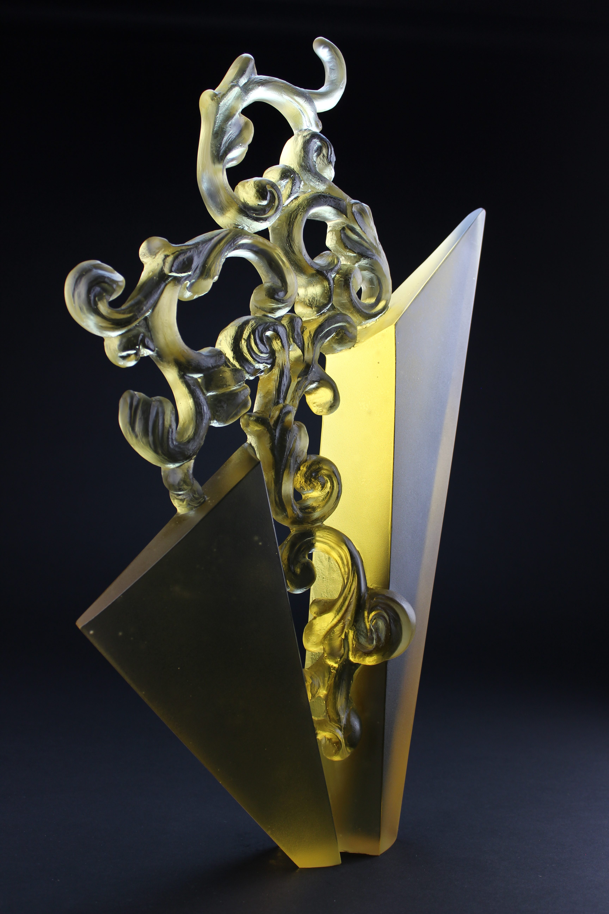
Yellow Deco mold melted, cut & polished glass 21” x 12” x 2.5”
2020
Opal Deco mold melted, cut & polished glass 19” x 13” x 2.75”
2020
Notes:
In these last works I hope to demonstrate the successful combination of the latter ideas. Utilizing the filigree as an organic components juxtaposed with the geometric elelements is heightened by the refinement of the marterial.

